Slide 1
Celebrating the 2600th Anniversary of the Bhikkhuni Sangha And Honoring All Bhikkhunis, Past and Present, East and West Alliance for Bhikkhunis, 2016

Slide 2
Ayya Tathaaloka Dhammadharini
“We will be beginning our year-long commemoration of the 2600-Year Anniversary of the Bhikkhuni Sangha this coming September full moon. I feel it is an important time to take stock, look at where we were a hundred years ago, where we are now, the challenges we face, and what our strategy is to work effectively with them.”

Slide 3
What is a Bhikkhuni?
A Short History of the Bhikkhuni Order
Demise of the Theravada Bhikkhuni Order
Revival of the Modern Bhikkhuni/Bhiksuni Order
AfB Honors Mahatheris
Honoring Some Current Bhikkhuni Theris
Theravada Bhikkhuni Ordinations Continue Around the World
Alliance for Bhikkhunis

Slide 4
What is a Bhikkhuni/Bhikshuni?
A bhikkhuni (Pali) or bhikshuni (Sanskrit) is a fully-ordained female Buddhist monastic.
A bhikkhu/bhikshu is a fully-ordained male monastic.
Both bhikkhus & bhikkhunis are ordained by receiving the precepts of the Vinaya (monastic discipline).
.
Notes:
First, what is a Bhikkhuni/Bhikshuni?
A bhikkhuni (Pali) or bhikshuni (Sanskrit) is a fully-ordained female Buddhist monastic.
A bhikkhu/bhikshu is a fully-ordained male monastic.
Both bhikkhus & bhikkhunis are ordained by receiving the precepts of the Vinaya (monastic discipline). The bhikkhunis Patimokkha has 311 rules. The bhikkhu Patimokkha has 227 rules.
The Alliance for Bhikkhunis was founded in 2007 to help support Buddhist women who have chosen this path, especially Theravada women who take a vow of poverty and are totally dependent on others for their support.

Slide 5
Some Helpful Theravada Words
Anagarika: is a person who has given up most or all of her worldly possessions and responsibilities to commit full-time to Buddhist practice. It is a midway status between nun and layperson where one takes on the Eight Precepts for the entire anagarika period.
Samaneri: a woman under the age of 20 cannot ordain as a bhikkhuni, but can ordain as a samaneri, a novice nun. Samaneris keep the 10 precepts as their code of behavior, and are devoted to the Buddhist religious life.
Bhikkhuni: is a fully ordained female monastic. (Male monastics are called bhikkhus.) Both bhikkhunis and bhikkhus live by the Vinaya, a set of rules. A woman who has taken final ordination lives by 311 precepts.
Mae chee: An 8 precept nun (Thailand)
Siladhara, Dasilamata (Sri Lanka) and Thilashin (Burma): A 10 precept nun

Slide 6
Terms of Address for Bhikkhunis
Ayya/Ayye: meaning ‘Venerable Sister’
Theri: meaning ‘Elder’ (after 10 years as a bhikkhuni)
Mahatheri: title meaning ‘Great Elder’. It is conferred after 20 vassas (rains retreats/years) as a bhikkhuni.

Slide 7
Beginnings of the Bhikkhuni Order
Notes:
According to Buddhist ‘scriptures’, about five years after his enlightenment, the Buddha was in Kapilavatthu at the Banyan Park Monastery. His aunt Mahapajapati Gotami, who raised him after the death of his mother, came to him and begged to be admitted to an order of nuns. He at first refused. Then Mahapajapati shaved her head and came again with 500 women in yellow robes to see the Buddha in Vesali. Ananda interceded on their behalf and convinced the Buddha to allow them to ordain.

Slide 8
Ananda is supposed to have said,
“Lord, if women were to go forth from the home life into homelessness in the Tathagata’s Dhamma-Vinaya, would they be able to realize the fruit of stream-entry, once-returning, non-returning, or arahantship?”
“Yes, Ananda, they would…….” (Culavagga)

Slide 9
As Ayya Tathaaloka explains:
According to Theravada tradition, the Buddha taught from age 35 until his Parinibbana at age 80, for a span of 45 years. The Bhikkhuni Sangha was founded in the year 583 or 584 BCE (depending on calendar), 40 years before his Parinibbana.
The Bhikkhuni Sangha was inaugurated on the September full moon (Binara Poya Day according to Sri Lankan Theravada traditional Buddhist calendar).
This places the 2600-Year Anniversary of the Bhikkhuni Sangha date between the 2016 and 2017 September full moons, depending on counting system.

Slide 10
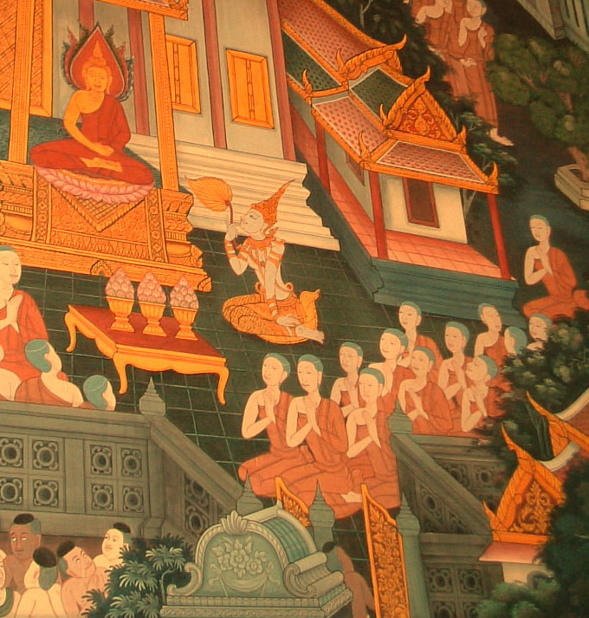
Many Enlightened Bhikkhunis
The Thirteen Great Arahant Bhikkhuni Disciples, mural in Wat Pho, Bangkok, Thailand
Notes:
The Buddha became convinced of the women’s ability to practice and extolled the attainments of the many enlightened bhikkhunis in his Assembly. (As the Buddha had two chief male disciples, Sariputta and Moggallana, he likewise had two foremost female monks, bhikkhunis, Uppalavanna and Khema. ) This mural on a wall in Wat Pho, Bangkok, Thailand depicts the Thirteen Great Arahant Bhikkhuni Disciples.

Slide 11
Dhammadinna
She who has given rise to the wish for freedom
and is set on it, shall be clear in mind.
One whose heart is not caught in the pleasures of the senses,
one who is bound upstream, will be freed.
Therigatha: Poems of the First Buddhist Women, p 13.
Notes:
Dhammadinna was one of the early bhikkhunis.

Slide 12
The Fourfold Sangha
Before he died the Buddha said: “I will not pass away…until I have bhikkhu disciples...bhikkhuni disciples...layman disciples… laywoman disciples who are accomplished, disciplined, skilled, learned, expert in the Dhamma.”
From the Mahaparinibbana Sutta
Notes:
Before he died the Buddha said: “I will not pass away…until I have bhikkhu disciples...bhikkhuni disciples...layman disciples… laywoman disciples who are accomplished, disciplined, skilled, learned, expert in the Dhamma.”
This is known as the Four-fold Sangha.

Slide 13
Mural of
Fourfold Assembly
at Wat Pho, Bangkok, Thailand
Notes:
The Four Fold Sangha: The bhikkhunis are on the right of the Buddha. Below them are the upasikas, female lay practitioners. Left of the Buddha are bhikkhus. Beneath them are the upasaka, male lay practitioners.

Slide 14
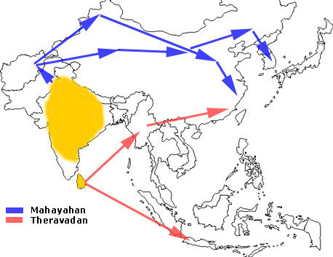
The Spread of Buddhism and the Bhikkhuni Sanga
Notes:
Buddhism spread from India to northern Asia (in the form of Mahayana Buddhism) and from Sri Lanka to South East Asia (in the form of Theravada Buddhism). And with it spread the bhikkhuni sangha.

Slide 15
Bhikkhuni Sanghamitta, with the Bodhi-Tree sapling, lands in Sri Lanka, greeted by King Tissa.
Notes:
By the time of Emperor Asoka (304-232 BC), Buddhism was well established in India. In 245 BCE, the daughter of Asoka, Arahanta Bhikkhuni Sanghamitta Theri, whose name means “Friend of the Sangha” left her home in India and travelled to Sri Lanka to establish the bhikkhuni sangha there. It is from Sri Lanka that Buddhism and the bhikkhuni sangha spread throughout Asia, and the world. She brought with her a cutting of the cutting from the Bodhi-Tree carried in a golden vase. When she landed in Sri Lanka she was welcomed by King Tissa himself with great veneration for Bhikkhuni Sanghamitta and for the sapling. He is also supposed to have waded into the water up to his neck to greet her and accept the tree. You can see him is the lower right corner of this picture.

Slide 16
Bhikkhuni Sangha Spreads to China
In 429 CE, Sri Lankan Bhikkhuni Devasara traveled to China with a group of bhikkhunis to establish a bhikkhuni sangha there.
Notes:
In 429 CE, Bhikkhuni Devasara, a Sri Lankan nun, took a cutting from the Sri Lanka tree grown from a cutting from the Indian Bodhi Tree and traveled to China with a group of bhikkhunis to establish a bhikkhuni sangha there. These Sri Lankan bhikkhunis gave higher ordination to more than 300 Chinese nuns at a monastery in Nanjing. A second group followed in 433 CE. This lineage would serve a key role in modern times.

Slide 17
China’s bhikkhuni lineage, originating from Sri Lanka, has continued to the present day in an unbroken upasampada (ordination) lineage. This lineage eventually spread to Taiwan, Korea, and Vietnam.
Notes:
There are now thousands of Taiwanese, Korean, Vietnamese, and Chinese bhikkhunis. This unbroken lineage became very important about 1500 years later, as we shall see, when the Mahayana bhikkhunis from these orders were able to help their Theravada sisters revive their Sangha.

Slide 18
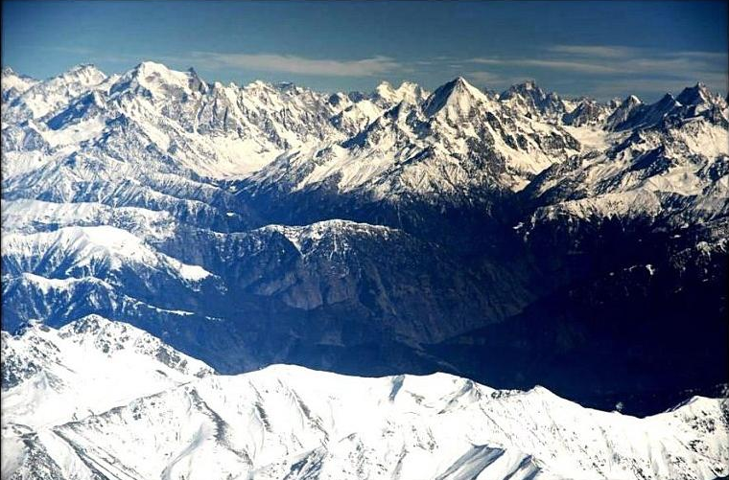
One Major Thing Prevented the Spread of the Bhiksuni Order to Tibet
Notes:
The bhikshuni lineage was not established in Tibet due to the difficulty in crossing the Himalayas. While there are a few historical records of a few bhikshunis in Tibet receiving their ordination from the bhikshu sangha alone, it never took hold in Tibet, because a sufficient number of Indian bhikshunis did not go to Tibet, nor did sufficient number of Tibetan women go to India to take ordination and return to Tibet to be able to pass it on to others.

Slide 19
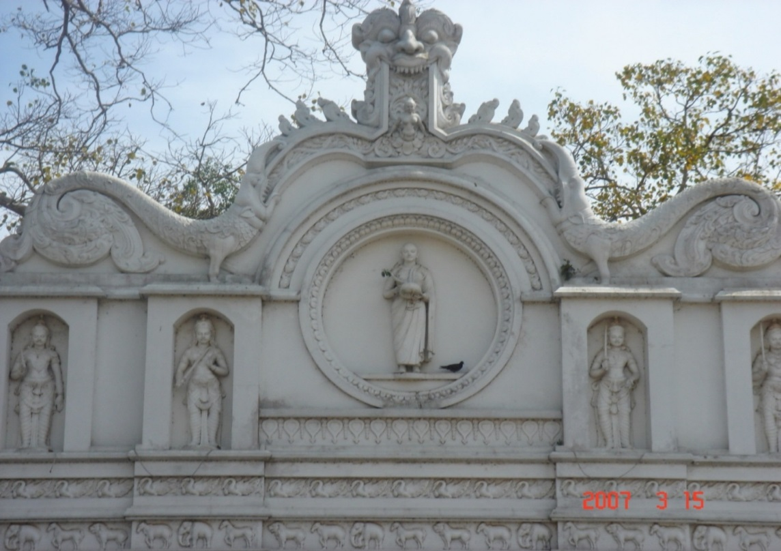
Disappearance of the Bhikkhuni Sangha in India and Sri Lanka Between the 11th and 14th centuries CE both the Bhikkhu and Bhikkhuni Sanghas died out in India and Sri Lanka due to invasions, war, and famine,
Sanghamitta Shrine, Kelaniya, Sri Lanka
Notes:
Between the 11th and 14th centuries CE both the bhikkhu and bhikkhuni sanghas died out in India and Sri Lanka due to invasions, war, and famine. Not long afterward, at the request of the new Sri Lankan king, the Sri Lankan Bhikkhu Sangha was reestablished with the help of bhikkhus from nearby countries.
There was thought to re-import the bhikkhuni sangha from Burma where there were still bhikkhunis. However, they were of another order, and the choice was made, by the then political and religious leaders, not to re-import the Bhikkhuni Sangha ordination lineage. So it died out in the Theravada tradition until within the last 50 years.

Slide 20
With a little help from our friends (sisters)! Bhikshunis in Taiwan, Korea and Hong Kong Helped Revive the Bhikkhuni/Bhiksuni Sanghas in the Theravada & Tibetan Traditions
1900s - Revival of the Modern Theravada and Tibetan Bhikkhuni Sanghas
Unmoonsa Bhikkhuni Monastery
& Sangha University, South Korea
Notes:
In part bhikkhuni and bhiksuni orders around the world owe a debt of gratitude to their Mahayana sisters. You remember that 1500 years ago Sri Lankan bhikkhunis carried the bhikkhuni order to China, and hence to Korea and Taiwan. Over the centuries Bhikkhuni orders thrived in these countries.
In recent years these Mahayana sisters, along with supportive monks, many from Sri Lanka, have been able to ordain women who practice in both Theravada and Vajrayana (Tibetan) tradition. There are now over 1000 bhikkhunis in Sri Lanka and about 50 bhikkhunis or samaneris in Thailand. Many Thai women traveled to Sri Lanka to ordain, back to where Sanghamitta Bhikkhuni started her sangha.

Slide 21
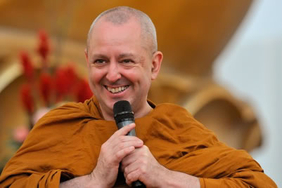
Mahayana Ordination Almost Identical to Theravada Ordination Ceremony
“In all the Mahayana schools whether in Tibet, China, Korea, or Vietnam, they follow mostly a Dharmagupta Vinaya. Dharmagupta is one of the Theravada sects. ”
Ajahn Brahm
Notes:
When this began some Theravadan monks questioned the validity of this ordination. Numerous monastics have researched this, including Ayya Kusuma. Ajahn Brahm, who has been a great supporter of bhikkhunis, says that his research shows that they are almost identical.
He said, "One of the biggest myths is that bhikkhunis under the Mahayana tradition is somehow separated from the Theravada. But the truth of the matter is, there is no such thing as a Mahayana Vinaya. In all the Mahayana schools whether in Tibet, China, Korea, or Vietnam, they follow mostly a Dharmagupta Vinaya. Dharmagupta is one of the Theravada sects. If you see an ordination ceremony in Taiwan – I saw a video of one that was recently conducted - you’d see the similarity. I had a copy of the chanting. It was almost identical with the ordination ceremony which is done say in Wat Bovorn here in Bangkok . ”

Slide 22
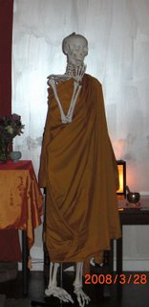
I’ve been waiting for
bhikkhuni ordination
for such a long time…
From Santi Forest Monastery Website
Notes:
A little bhikkhuni humor.

Slide 23
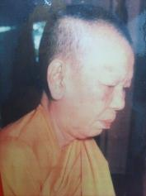
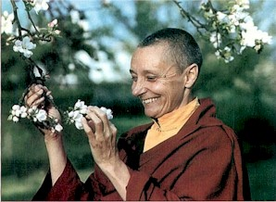
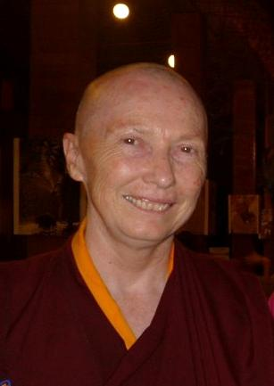
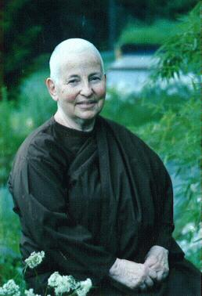
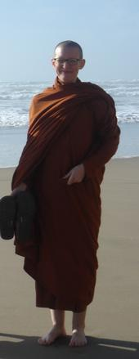
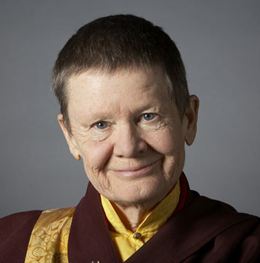
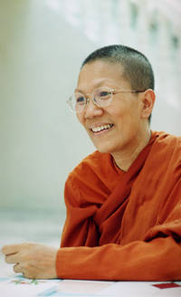
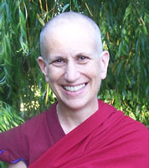
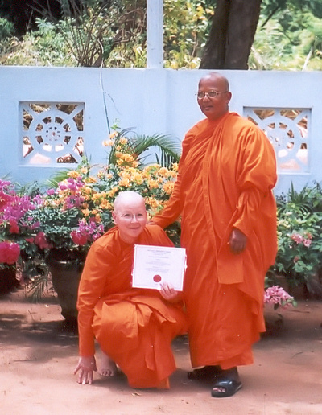
Some Modern Bhikkhuni and Bhiksuni Pioneers
Notes:
Not only have today’s bhikkhunis and bhiksunis been helped by their Mahayana sisters, but they also stand on the shoulders of some very courageous and pioneering women, women who followed the example of their predecessor Bhikkhuni Sanghamitta. We’ll meet a few of them and see how their Mahayana sisters played a part in the ordinations of these women and their contributions to the revival of the Bhikkhuni order.

Slide 24
First Thai woman to become a bhikkhuni
Bhikkhuni Tao Fa Tzu
1908 Born Voramai Kabilsingh Shatsena
1955 Ordained as a samaneri (10 precepts)
1971 Lacking full ordination in Thailand, she traveled to Taiwan for bhikkhuni ordination
Established Sondhammakalyani Temple outside of Bangkok
Her daughter Ayya Dhammananda is now the most prominent bhikkhuni in Thailand, and is a pioneer in reviving the bhikkhuni order in Thailand.
Notes:
Voramai Kabilsingh Shatsena, a Thai wife and mother, who had been married to member of parliament, began her monastic life by receiving the ‘Eight Precepts’ and lived as a mae chee for 15 years.
-She was then ordained as a samaneri with the 10 precepts by an eminent Thai bhikkhu in a Wat in the royal residence.
-Since she could not be fully ordained in Thailand, she traveled to Taiwan to ordain as Venerable Ta Tao Fa Tzu.
-She established Sondhammakalyani Temple outside of Bangkok on land purchased by the Queen, published a Buddhist monthly magazine for 32 years and was very involved with social welfare. “Venerable Grandma”, as she was known, died in 2003.
Her daughter, Ven. Bhikkhuni Dhamananda, was the first Thai bhikkhuni ordained in the Theravada tradition.

Slide 25
During the next 16 years, four pioneering women, practicing in the Tibetan tradition, also received bhikkhuni ordination from their Mahayana sisters. They were also very helpful in the future ordinations of Theravada bhikkhunis

Slide 26
1973: Bhiksuni Jetsunma Tenzin Palmo in Hong Kong
3) 1982: Bhiksuni Karma Lekshe Tsomo, Ph.D. in South Korea
2) 1981: Bhiksuni Pema Chodron in Hong Kong
4) 1987: Bhiksuni Thubten Chodron in Taiwan

Slide 27
1988 – An ordination was held at Hsi Lai Monastery in Los Angeles by Taiwanese bhikkhus and bhikkhunis.
Shortly after this, Theravada Bhikkhuni Ordinations Began
To our knowledge, 3 of these bhikkhunis (now Mahatheris!) are still living: Mahatheris Dhamma (Germany); Darsika (Sri Lanka) & Dammavati (Nepal).
Notes:
In 1988 a group of Sri Lankan ten-precept nuns ordained at Hsi Lai Monastery in Hacienda Heights, Southern California. That group included Ayya Khema, Ven. Dharmapali (the first American bhikkhuni - now disrobed), the first Nepalese Theravada bhikkhunis in modern times including Ven Dhammawati; Ven. Dhamma (Germany) and Darsika (Sri Lanka.) We understand these last three women are living and would now be Mahatheris!
Sadly, without support, some were not able to remain as bhikkhunis. (It was awareness of this situation that later inspired Susan Pembroke to found the Alliance for Bhikkhunis, to help support bhikkhunis, but more about that later.)

Slide 28
Ayya Khema (b. Berlin 1923 – d. Buddhahaus, 1997)
-1979 first Western woman to ordain as a Theravada samaneri .
-1987 co-organized the first international conference of Buddhist nuns, resulting in the founding of Sakyadhita.
-First Buddhist nun to address the U.N. in N.Y. in 1987.
-1988 fully ordained in the Los Angeles Chinese temple Hsi Lai (Taiwanese).
The inspiration for the creation of the Alliance for Bhikkhunis
Notes:
In 1979 Ayya Khema first ordained as a 10 precept nun in Sri Lanka, where she was active in restoring full ordination for women and setting up many training centers for nuns. Ayya Khema was fully ordained in a Taiwanese temple in Los Angles in 1988. Along with Bhiksuni Lekse Tsomo, she co-founded Sakyadhita. In 1987 she was the first Buddhist nun to address the UN.

Slide 29
Theravada Mahatheris for the First Time in Centuries!
Mahatheri is a title meaning ‘Great Elder’. It is conferred after 20 vassas (rains retreats/years) as a bhikkhuni.
In 2008, the bhikkhunis ordained in 1988 became the first Theravada Mahatheris in centuries!

Slide 30
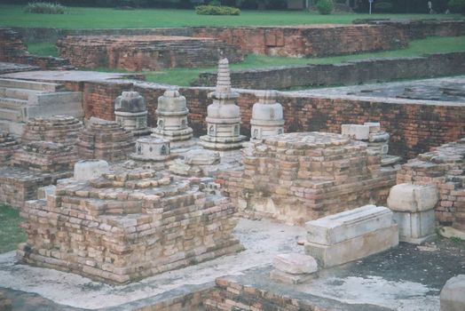
Theravada Bhikkhuni reestablished in Sri Lanka.
K. Kusuma
Habarana Chandradassi
Matale Vijitha
Galle Subhadra
Bandarawela Sudhammika
Peliyagoda Sudharshana
Pandura Wekada-Bhadra
Passara Sama
Kurengala Subhadra
Kurunegala Hemapali
1996 – Organized by Sakyadhita, the Korean Bhikkhu Sangha & Sri Lankan monks sponsored a bhikkhuni ordination for 10 Sri Lankan dasasilmatas in Sarnath, India.
Notes:
In 1996, Sakyadhita, along with South Korea & Sri Lankan monks organized and sponsored the first International higher ordination in Sarnath, India. At that time 10 Sri Lankan nuns received full ordination as bhikkhuni. Although it did not occur in Sri Lankan it reestablished the Bhikkhuni sangha in Sri Lanka. These bhikkhunis then served and important roll in ordaining other bhikkhunis around the world.

Slide 31
The First Sri Lankan Bhikkhunis 1996 Sarnath, India
A very grainy, but historic, photo, from the Dharma Vijaya Buddhist Vihara Silver Jubilee Issue (1955-2005)

Slide 32
With this year, More Theravada Mahatheris!
In addition to the three previously named Mahatheris, in 2016, Ayya Kusuma, Ayya Sudharshana and all the other Sri Lankan bhikkhunis ordained at the 1996 ordination, became Mahatheris. (We trying to locate some of the others.)
Something else to celebrate along with the 2600th anniversary of the bhikkhuni sangha!
Notes:
Ayya Tathaaloka, talking about the next two years: I would like to highlight though, that all of those bhikkhunis ordained in the primary arising time of the Theravada Bhikkhuni Revival--in late 1996, early 1997 & early 1998--will be becoming Mahatheris, with 20 vassas as bhikkhunis, during this period

Slide 33
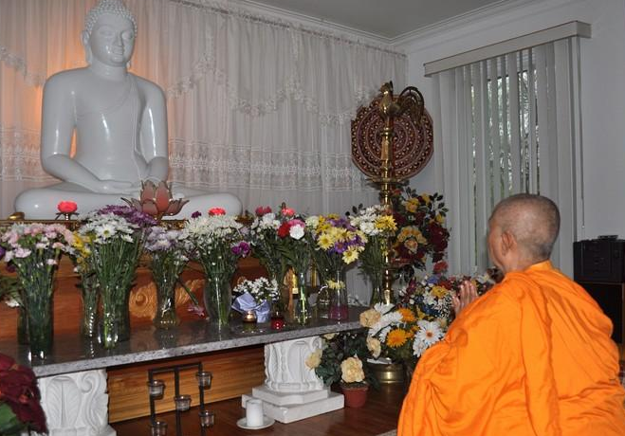
Bhikkhuni Kusuma Mahatheri
Bhikkhuni Kusuma was one of 10 Sri Lankan women ordained in 1996 in Sarnath, India. On this 20th anniversary, she is now a Mahatheri.
Notes:
One of those Sri Lankan women was Ven. Bhikkhuni Kusuma MA. PhD. She has pioneered the re-establishment the Theravada Bhikkhuni Sangha in Sri Lanka and has taken upon herself the task of carrying on the efforts of her mentor, Ayya Khema, in establishing the 'Ayya Khema International Buddhist Mandir.

Slide 34
Bhikkhuni Sudarshana Mahatheri
1968 Born in Sri Lanka
1985 Samaneri ordination Sri Lanka
Earned a bachelor’s degree and 2 masters degrees
1996 Bhikkhuni Ordination in Sri Lanka
Organized bhikkhuni ordinations in 2001, 2002, 2003, 2016
Since 2003 Abbess of Samadhi Meditation Ctr., Pinellas Park, FL
Ayya Sudarshana (top L.) a preceptor at 2016 ordination at Dharma Vijaya, with Ayya Gunasari, Ven. Uttama, Ayyas Dhammadhira & Anandabodhi

Slide 35
Honoring Theris
Theri: meaning ‘Elder’, is a title given after 10 years as a bhikkhuni.
As of the 2016-2017 anniversary year, there are many bhikkhunis who are now Theris
We would like to recognize and honor some of them

Slide 36
1997 International Buddhist Meditation Center (IBCM), Los Angeles
20 Women from Sri Lanka, Nepal and USA by Taiwanese and Sri Lankan bhikkhus and bhikkhunis
Ayya Tathaaloka was ordained at this time
Ven. Dr. Karuna Dharma and Ven. Dr. Ratanasara serving as preceptor and confirming monk.

Slide 37
Ayya Tathaaloka
1968 Born in Washington, DC
1987 Ordained as an anagarika, traveled & studied in India, South Korea & Thailand
1997 Ordained as a bhikkhuni in Los Angeles at Int’l Buddhist Meditation Center
2005 Founded Dhammadharini Vihara in Fremont, CA and Aranya Bodhi Hermitage in northern CA
2016 Purchased land and opened new monastery at Penngrove, CA

Slide 38
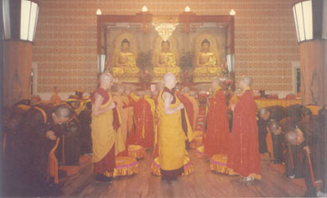
1998 International Full Ordination Ceremony in Bodhgaya, India
Bhikshunis-to-be pay respects to their preceptors, Bhiksunis Thubten Chodron & Karma Lekshe Tsomo
(Ayya Sucinta of Germany ordained with this group.)
Notes:
Like Sanghamitta, the women who ordained earlier taught and ordained other women. In 1998, Bhiksunis Thubten Chodron and Karma Lekshe Tsomo ordained new bhiksunis at Bodhgaya, India. Among them were Ayyas Sucinta, Saddha Sumana, Sumitra.

Slide 39
Ayya Sucinta
1950 Born in Germany
1991 Anagarika ordination at Amravati Monastery, UK
Samaneri ordination at Bhavana Society, WVa
1998 Bhikkhuni Ordination Bodhgaya, India
Practiced in Burma, US, Australia
Since 2010 Abbess of Anenja Vihara, Germany
Notes:
Also ordained at this time were Ayyas Sumitra, Saddha Sumana (both from Sri Lanka)

Slide 40
Bhikkhuni Rahatungoda Saddha Sumana Sri Lanka
Born in Sri Lanka
1998 Bhikkhuni ordination at Bodhgaya, India
Helped train the first Thai bhikkhunis at Wat Songdhammakalyani Monastery
2001 Gave Samaneri ordination to Ayya Dhammananda

Slide 41
Ayya Gotami (Dr. Prem Suksawat)
Born in Thailand
A psychiatrist and Ph.D.
1997 became a samaneri at Dharma Vijaya in LA
2000 Bhikkhuni ordination at Fo Guang Shan Temple in Taiwan
Dhamma Cetiya Buddhist Vihara, Boston

Slide 42
Ayya Sudinna
Born in Sri Lanka
Teacher and lecturer in English at Teacher’s College & Ministry of Education
1999 Samaneri ordination Bhavana Society, WVa
2002 Bhikkhuni ordination, Sri Lanka
Author of 3 children’s books
Resident bhikkhuni at South Carolina Buddhist Vihara

Slide 43
First Modern Bhikkhuni Ordination in Sri Lanka
2003 - First bhikkhuni higher ordinations in modern times on Sri Lankan soil. (American Bhikkhuni Ayya Sudhamma, Thailand’s Ven. Dhammananda, and Burmese born Ayya Gunasari & Ayya Saccavadi were ordained at this time.)
Notes:
In 2003, Sri Lanka came full circle from the time the Sanghamitta first brought the bhikkhuni sangha to the island. The first bhikkhuni higher ordinations in modern times were held on Sri Lankan soil. Ordained at that time were American Ayya Sudhamma, and Burmese Ayya Gunasari and Ayya Saccavadi, as well as Thailand’s Venerable Dhammananda . Ayya Gunasari was the first Burmese and Ven. Dhammananda the first Thai woman to be fully ordained as a Theravada bhikkhuni in modern times. Ayya Sudhamma has the distinction of being the first American woman to be fully ordained in Sri Lanka. In this same year, Vietnamese Bhikkhuni Dhammananda also ordained but at Anuradhapura, Sri Lanka.
Many of the bhikkhunis went on to build the bhikkhuni sangha. Ven. Sudhamma established the Carolina Buddhist Vihara, a Theravada Buddhist center in a small house in the suburbs of Greenville, SC. Ayya Gunasari is now the abbess of Mahapajapati Monastery near Joshua Tree, California. And Ven. Dhammananda is abbess of a monastery in Thailand (and the sculptor of the clay Sanghamitta image we saw earlier.)

Slide 44
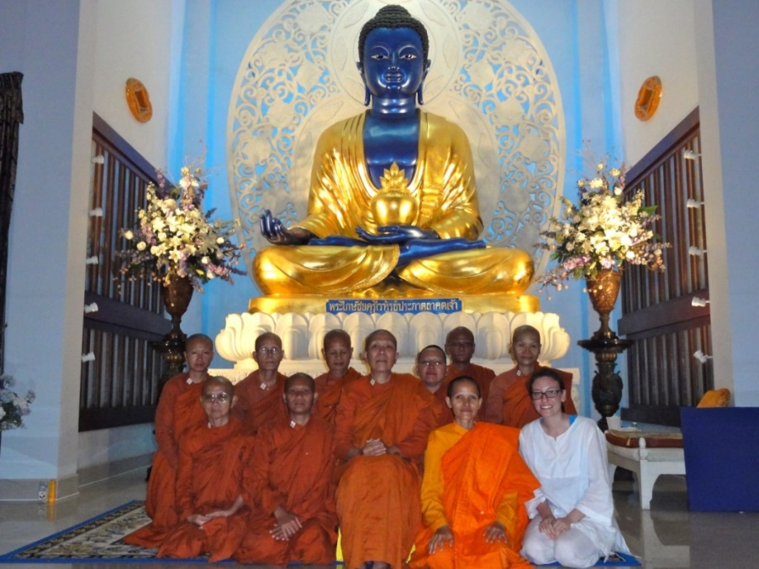
Bhikkhuni Dhammananda, Ph.D.
1945 Born Chatsumarn Kabilsingh in Thailand
(daughter of Bhikkhuni Tao Fa Tzu)
1975-2000 Professor of Buddhist philosophy at Thammasat University
2001 Received samaneri ordination
2003 Received full bhikkhuni ordination in Sri Lanka
-Now abbess of Songdhammakalyani Monastery, one of the few bhikkhuni temples in Thailand.
-Has begun ordaining new bhikkhunis in Thailand
Notes:
Ven. Dhammananda was the first Thai woman to ordain as a Theravada bhikkhuni. Her renowned mother Venerable Voramai ordained in a Taiwanese temple when Ven. Dhammananda was ten years old.

Slide 45
Ayya Gunasari
1932 Born in Burma (Myanmar)
Became a physician, anesthesiologist, raised 5 children
2002 At age 70 entered monastic life, samaneri ordination
2003 Bhikkhuni ordination in Sri Lanka
2007 Speaker 1st Global Congress of Buddhist Women
2007 Founded Mahapajapati Monastery in Joshua Tree, CA, where she is Abbess

Slide 46
Ayya Sudhamma
1963 born Charlotte, NC
Graduated from NYU Law School & practiced law in San Francisco
Studied with Bhante Gunarantara
2003 Bhikkhuni Ordination in Sri Lanka
2013 Founded Charlotte Buddhist Vihara, Abbess

Slide 47
In 2006, in a secret ceremony in the ancient ruins at Ayutthaya in Thailand, three more Thai women ordained as bhikkhunis − Bhikkhunis Rattanavali, Dhammamitta, and Silananda.
Notes:
In 2006, in a secret ceremony in the ancient ruins at Ayutthaya in Thailand, three more Thai women ordained as bhikkhunis − Bhikkhunis Rattanavali, Dhammamitta, and Silananda. Bhikkhunis Rattanavali, Dhammamitta, and Silananda now have their own viharas and are well supported by lay people in their communities.

Slide 48
Ayya Satima
Born and raised in Sri Lanka
1973 Came to the US as a Montessori teacher
2000 Ordained as a Zen nun
2004 Returned to Sri Lanka for samaneri ordination
2006 Bhikkhuni ordination at Golden Temple, Dambulla, Sri Lanka
Resident Bhikkhuni at Minneapolis Buddhist Vihara
‘Archie’ (Grandmother) is currently living in Colorado with family

Slide 49
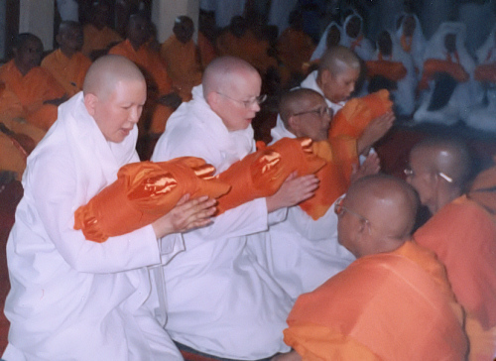
Ayya Sobhana Bhikkhuni
Trained by Bhante Gunarantara of Bhavana Society
2006 Higher ordination in Dambulla, Sri Lanka
Abbess of Aranya Bodhi Hermitage in Northern California
Notes:
Ayya Sobhana, trained by Bhante Gunarantara and ordained in Sri Lanka, has also been a prominent leader on the American bhikkhuni scene. She is the Abbess of Aranya Bodhi Hermitage in Northern California.

Slide 50
Bhikkhuni Visuddhi
Born in the Czech Republic; After practicing Buddhism for many years, went to Sri Lanka to become a nun
2003 Sāmaṇerī Ordination in Sri Lanka
Trained for 9 months in Taiwan, Fo Kuang Shan Temple
2006 Ordained as a Dharmaguptaka bhikṣuṇī at Tzu Yun Temple in Taiwan, Returned to Sri Lanka and lived as a nun in Theravāda bhikkhunī communities
2008 to Aneñja Vihāra in Germany
2012 Established Karuṇā Sevena Bhikkhunī Ārāma in the Czech Republic
2015 Dalhikamma Vinaya procedure and acceptance in the Therāvada Bhikkhu and Bhikkhunī Saṅgha in Sri Lanka

Slide 51
Ayya Medhanandi
Born in Canada
1988 10 precept ordination, Yangon, Myanmar (military coup forced her to leave and go to UK)
10 years as Siladhara, Amaravati in UK
6 years in New Zealand, then Penang
2007 Bhikkhuni ordination at Ling Quan Chan Monastery, Keelung, Taiwan
2008 Established Sati Saraniya Hermitage, Perth, Ontario, Canada

Slide 52
Hamburg Congress, 2007
Bhikkhunis and bhikshunis ordained earlier help to mentor and ordain new bhikkhunis.
Notes:
Called by His Holiness the Dalai Lama, The Hamburg Congress in 2007, called, “The First International Congress of Buddhist Women’s Role in the Sangha” brought the issue of full ordination for women into world attention. Leading Buddhist monastics met to discuss the history and legitimacy of the ordination of women.
Pictured, left to right: Burmese Bhikkhuni Ven. Gunasari (retired physician); American Ven. Sudhamma; British-born Ven. Tenzin Palmo (Cave in the Snow); American Ven. Tathaaloka, abbess of Dhammadharini; Ven. Dhammananda, first Thai bhikkhuni, renowned scholar

Slide 53
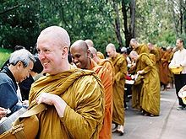
Rocking the Boat
2009 − With Ayya Tathaaloka as preceptor and Ajahn Brahm as certifying acariya, four samaneris were ordained as bhikkhunis at Bodhinyana Monastery in Serpentine, Australia.
Ajahn Brahm was then “delisted” from the Ajahn Chah lineage.
Ajahn Brahm and other monks
Notes:
As we mentioned the Thai Theravada tradition had forbid the ordination of bhikkhunis. In 2009, Ajahn Brahm took a very bold step. With Ayya Tathaloka as the preceptor, supported by Ayyas Sobhana and Sucinta, four nuns were ordained as bhikkhunis at Bodhinyana Monastery in Serpentine, Australia. Ajahn Brahm was a confirming bhikkhu. Since Ajahn Brahm was in the Ajahn Chah Thai lineage, which does not allow full ordination for women, Ajahn Brahm was ordered to Wat Pah Pong in Thailand. He was asked to recant and declare the ceremony was invalid and that these women were not bhikkhunis. He refused, and he and his monastery were “delisted” from the lineage he’d been part of for about 35 years.

Slide 54
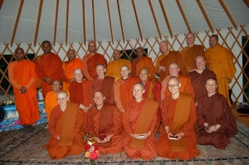
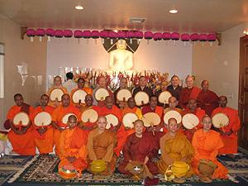
August 2010 Bhikkhuni Ordination of four bhikkhunis at Aranya Bodhi Hermitage, Northern California
October 2010 Bhikkhuni Ordinations at Dharma Vijaya in Los Angeles
Notes:
In 2005, the North America Bhikkhuni Association was established. Since then it has almost doubled in size.
In Aug. 2010 four women were ordained by Ayya Tathaaloka at Aranya Bodhi. After being ordained by the Bhikkhuni Sangha on one side, the bhikkhunis then went over to the assembled Bhikkhu Sangha for the confirmation of their ordination, which completed the bhikkhuni ordination. The four samaneri ordained as bhikkhunis: Ven. Thanasanti Bhikkhuni (United States), Ven. Adhimutta Bhikkhuni (New Zealand), Ven. Suvijjana Bhikkhuni (United States), and Ven. Phalanani Bhikkhuni (Germany) were ordained as bhikkhunis (fully ordained nuns) in the Theravada Buddhist tradition.
The following month five women were fully ordained at Dharma Vijaya in Los Angeles.
Three ceremonies were held on the same day. The first was for a Canadian-born woman, Brenda Batke-Hirschmann, who became an anagarika by taking Eight Precepts; the second was for two American-born anagarikas who received ordination as samaneris; and the third was for five samaneris who took full upasampada, or higher ordination, as bhikkhunis. The new samaneris are Santussika and Dhammapali; the new bhikkhunis are Lakshapathiye Samadhi (born in Sri Lanka), Cariyapanna, Susila, Sammasati (all three born in Vietnam), and Uttamanyana (born in Myanmar).

Slide 55
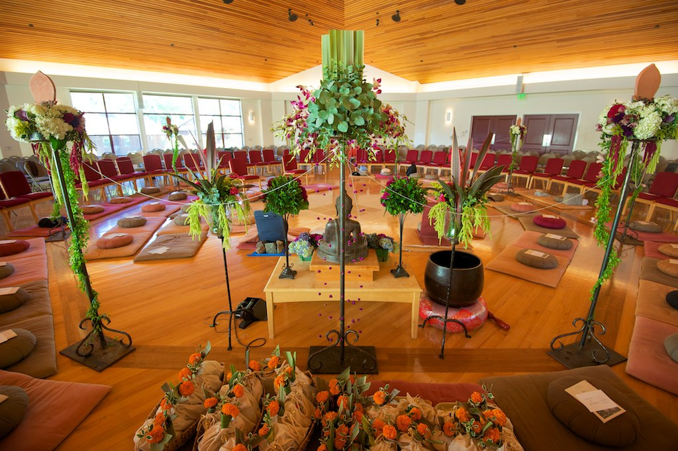
Three More North American Bhikkhunis Spirit Rock Meditation Hall – Oct. 17, 2011
A Sima of Flowers
L-R: Ayya Nimmala, Sate Saraniya Hermitage, Ontario, Canada; Ayya Santacitta and Ayya Anandabodhi, Aloka Vihara, San Francisco, California
Notes:
Recent bhikkhuni ordinations took place on Oct. 17, 2011 at Spirit Rock Meditation Hall. It was significant is that it was very much ‘mainstream’ and widely attended by bhikkhus and bhikkhunis from around the world.
–L-R: Ayya Nimmala, Sati Saraniya Hermitage, Ontario, Canada; Ayya Santacitta and Ayya Anandabodhi, Aloka Vihara, San Francisco (now Placerville), California.
For an ordination, or any monastic ceremony, a sima, or sacred circle is established within which only the monastics are allowed. At monasteries in Thailand old large dark stone markers are often used by monks to tie the string around. At this ordination the sima markers were tall plant stands with flowers cascading down from the pots. A very feminine touch.

Slide 56
New Bhikkhuni Training Monasteries
Aloka Vihara, Placerville, CA
Ayyas Anandabodhi & Santicitta,
Co-Abbesses
Dhammadharini, Penngrove, CA
Ayya Tathaaloka, Abbess
Notes:
Both Dhammadharini and Aloka Vihara started out in rented facilities. In the past two years, land and houses have been purchased by the Sanghas, which is a big step in establishing a permanent base from which to grow.

Slide 57
Aloka Vihara’s First Ordination
Jayati Bhikkhuni, a former Siladhara from Amaravati, is ordained by preceptor Ayya Tathaaloka at the new Vihara.

Slide 58
First Bhikkhuni Ordination in Europe Anenja Vihara June 21, 2015
Newly ordained Bhikkhuni Dhira with ordaining bhikkhuni and bhikkhu sangha

Slide 59
Most Recent Bhikkhuni Ordination Aug. 7, 2016 Dharma Vijaya, Los Angeles
Maha Sangha gathered at Dharma Vijaya
to support the ordinations
Bhikkhuni ordination of Vimala (Belgium)
and Satima (Sri Lanka)
Notes:
Ayya Anandabodhi’s comment on the ordination:
“Having known Bhante Piyananda for many years, Sm. Satima had come from Sri Lanka to take Bhikkhuni Ordination and then return to her center there. Bhante commented on how extraordinary it is that California has become one of the most supportive places for women to ordain at this time, with women even coming from Buddhist countries to take the ordination back there! “
Ayya Anandabodhi, Aloka Vihara

Slide 60
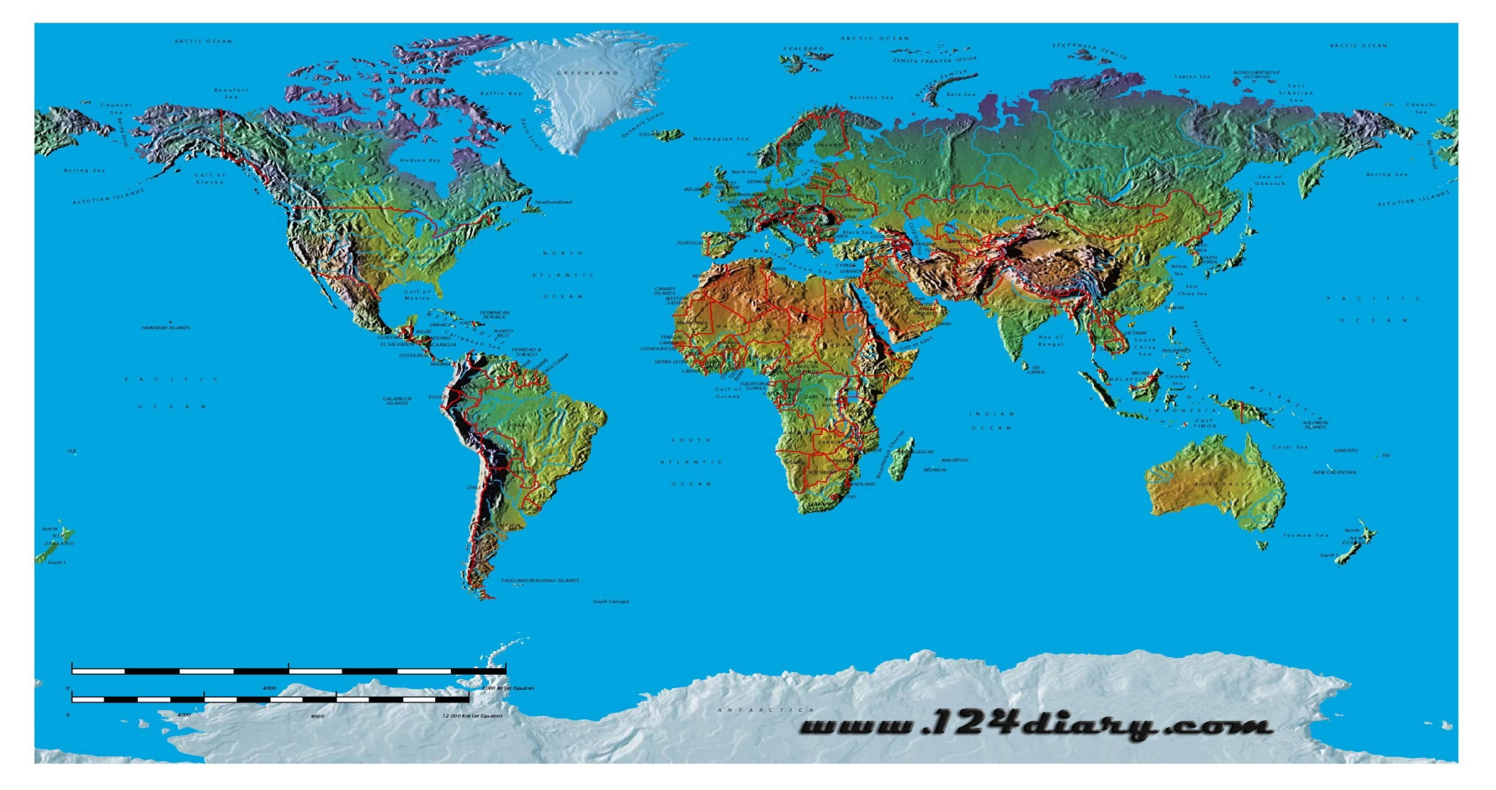
Bhikkhunis Worldwide!
With at least 8 ordinations occurring in the past 4 years, today there are now bhikkhunis & bhiksunis in the U.S., India, Italy, Germany, Canada, Australia, New Zealand, Sri Lanka, Thailand and Vietnam.
Notes:
Today there are bhikkhunis and bhikshunis worldwide!

Slide 61
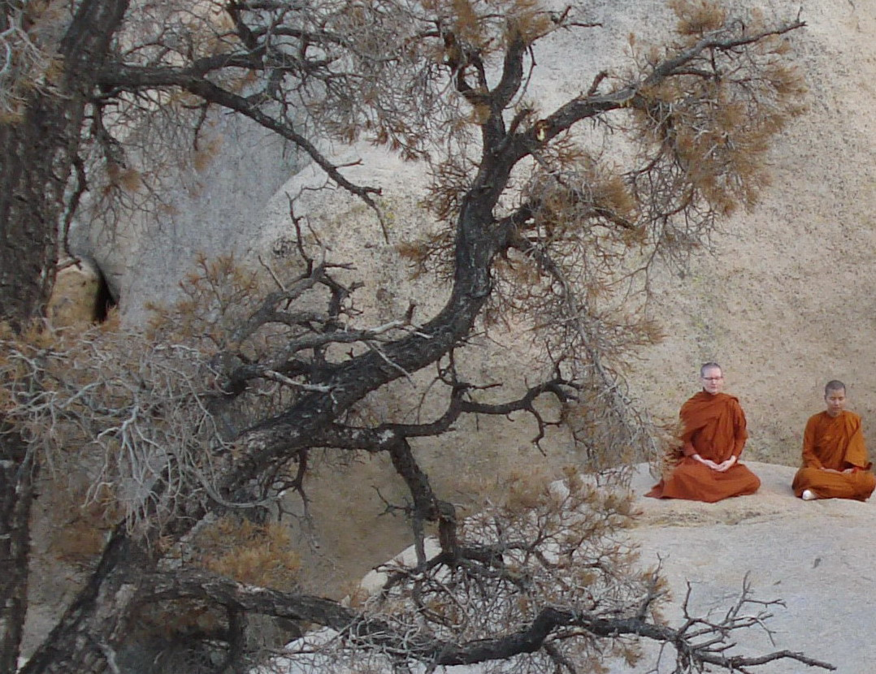
Alliance for Bhikkhunis
Alliance for Bhikkhunis (AFB) was founded in 2007 to support the creation of a Bhikkhuni Sangha in the U.S. and its revival overseas.
Bhikkhunis near Joshua Tree National Park, Mohave Desert, Southern California, USA
Notes:
So, now a little about Alliance for Bhikkhunis (AFB) and what they do. It was founded in 2007 by Susan Pembroke as a 501 (c)(3) non-profit organization to help support the creation of a Bhikkhuni Sangha in the U.S. and its revival overseas.
As we mentioned, Theravada bhikkhunis and bhikkhus take vows comparable to Christian vows of poverty. Their only possessions are their robes and their eating bowls. They cannot drive, handle money, hold jobs, cook their food, nor many other things. Try to imagine how you would exist if you lived like this. They are totally dependent of others for everything in their lives. Could you live like that? Give up all your attachments??!!

Slide 62
What Does Alliance for Bhikkhunis Do?
AFB educates lay practitioners about the essential role bhikkhunis play in preserving the Dhamma.
AFB offers financial assistance to provide monastics with their four requisites: food, clothing, shelter, and medicine/health care.
We need your donations to help us do this! We accept donations via Pay Pal or check; please go to www.bhikkhuni.net
We also post information on assistance needed for specific projects, based on requests we receive from nuns.
Notes:
Probably the two most important undertakings of the Alliance for Bhikkhunis are:
1) To educate lay practitioners about the essential role bhikkhunis play in preserving the dharma.
2) AFB offers financial assistance to provide monastics with their four requisites: food, clothing, shelter and medicine/health care

Slide 63
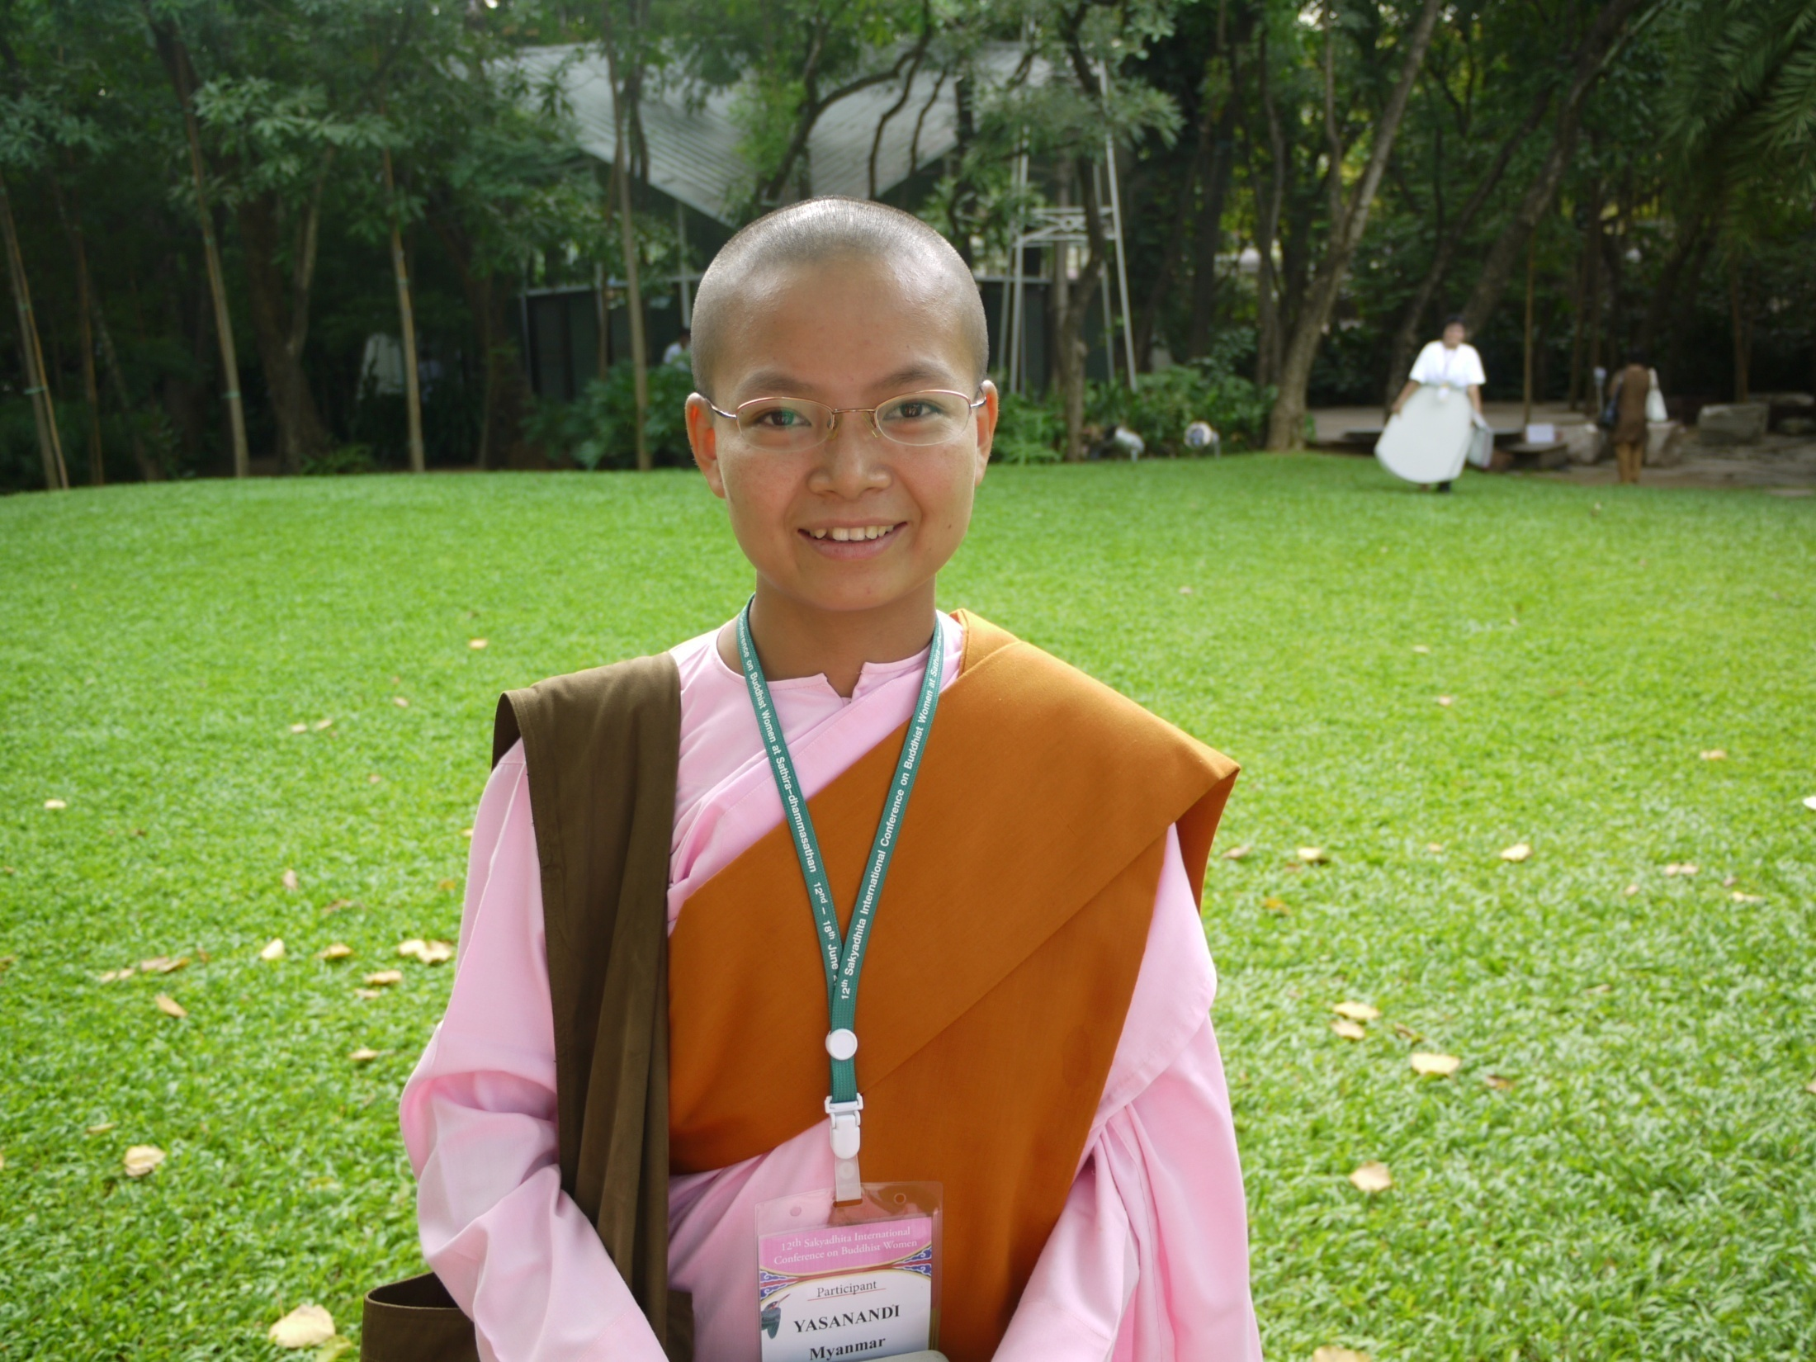
May all beings be happy!
Notes:
May all beings be happy.
AfB apologizes for any inadvertent errors contained in this presentation.

