Slide 1
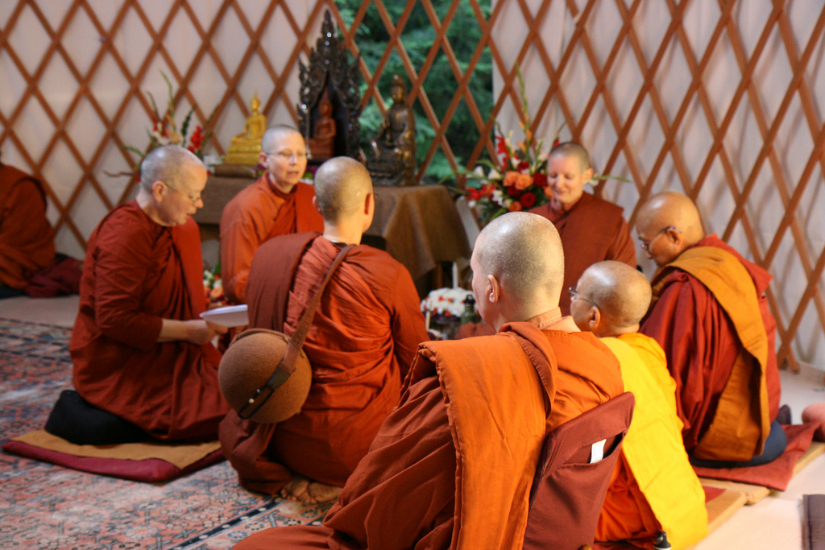
An Event for the Entire Community
Saturday September 21st 7-9 PM
Colorado College Cornerstone Arts Center, Screening Room
Southeast corner of Cascade and Cache La Poudre
Come join us in celebrating International Bhikkhuni (Buddhist nun) day with the movie:
The Buddha’s Forgotten Nuns,
First Theravada Bhikkhuni ordination in USA August 2010
and a panel discussion afterwards with +++
Ten years in the making, this documentary explores the controversy in reviving the Theravadan order of Bhikkhunis, or fully ordained nuns, created by the Buddha more than 2,500 years ago. The Theravadan lineage died out and efforts to reinstate it have encountered opposition.
Our panel will mainly address the conflict between Buddhism as a religious movement based on equality and its transmission from one male-dominated culture to another. Filmmaker Wiriya Sati travels throughout Asia and the West, discovering both intractable conservatism as well as those intent on pushing beyond cultural barriers.
Join us for the film, panel, and discussion. Come learn about the widespread ill effects of patriarchy and prejudice in world religions, and of the imperative of finding another way
Donations welcome for Alliance for Bhikkhunis - support for Theravada Bhikkhunis in North America
When monastics flourish, the whole community flourishes.

