Slide 1
Third International Bhikkhuni Day
September 21, 2013
Notes:
Welcome to International Bhikkhuni Day. Thank you for coming to share in this celebration. The purpose of this presentation is to ‘enlighten’ people about bhikkhunis, their history and their current situation.
1

Slide 2
This Year Honoring:
The Sisterhood of Eminent Bhikkhuni Teacher s and Leaders,
Past and Present
The ‘Seven Sisters: Spiritual Friendship, Companionship and Sisterhood, Then and Now
Notes:
This year the Alliance for Bhikkhunis is honoring The Sisterhood of Eminent Bhikkhuni Teachers and Leaders, past and present. We’re looking at how early Buddhist women monastics, like The Seven Sisters, and how their Spiritual Companionship and Friendships laid the foundations for the early Buddhist Sangha and how it relates to the sisterhood of bhikkhunis today.
2

Slide 3
What is a Bhikkhuni/Bhikshuni?
A bhikkhuni (Pali) or bhikshuni (Sanskrit) is a fully-ordained female Buddhist monastic.
A bhikkhu/bhikshu is a fully-ordained male monastic.
Both bhikkhus and bhikkhunis agree to live by the precepts of the Vinaya (monastic code.) Bhikkhuni ordinations are also confirmed and blessed by the Bhikkhu Sangha.
.
Notes:
First, what is a Bhikkhuni/Bhikshuni?
A bhikkhuni (Pali) or bhikshuni (Sanskrit) is a fully-ordained female Buddhist monastic.
A bhikkhu/bhikshu is a fully-ordained male monastic.
Both bhikkhus & bhikkhunis agree to live by the precepts of the Vinaya (monastic discipline). The bhikkhunis Patimokkha has 311 rules. The bhikkhu Patimokkha has 227 rules.
The Alliance for Bhikkhunis was founded in 2007 to help support Buddhist women who have chosen this path, especially Theravada women who take a vow of poverty and are totally dependent on others for their support.
3

Slide 4
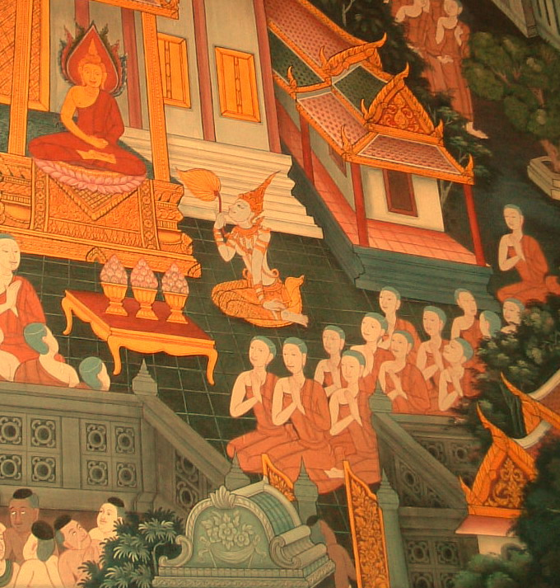
Bhikkhuni Sisterhood
in the Time of the Buddha
Notes:
At the famous Temple of the Reclining Buddha in Bangkok, Thailand there are wonderful pictures of bhikkhunis in the time of the Buddha. Here a group of bhikkhunis listening to a dhamma talk by the Buddha.

Slide 5
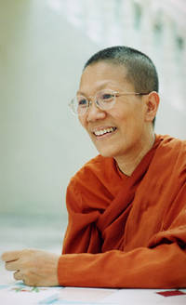
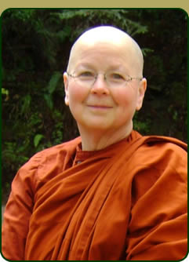
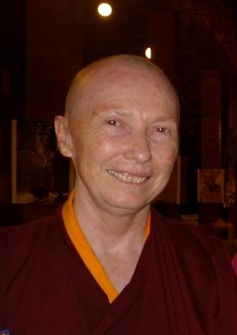
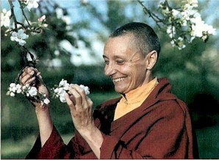
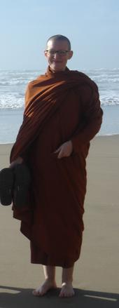
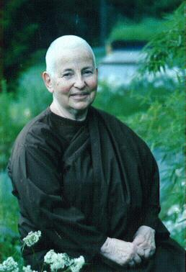
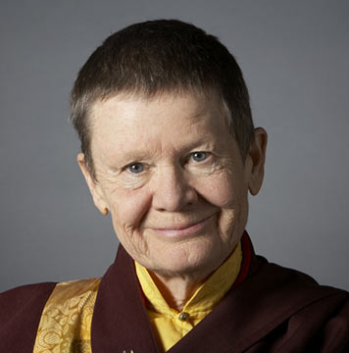
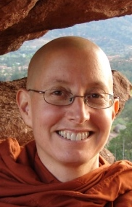
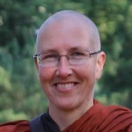
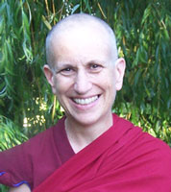
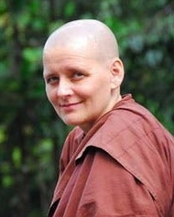
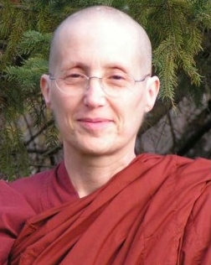
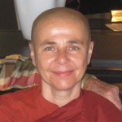
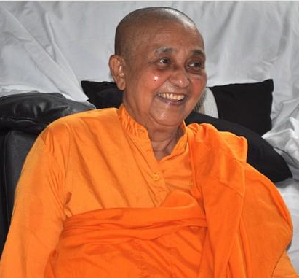
Some of Today’s Sisters
Notes:
And here are pictures of some of today’s bhikkhuni sisters, of several different traditions
These are gatherings of women, many of them friends, often spanning groups and traditions. The women are drawn together, held together, uplift and support one another, by their companionship and by their practice of the path for common goal together. This is the meaning of the Story of the Seven Sisters .
5

Slide 6
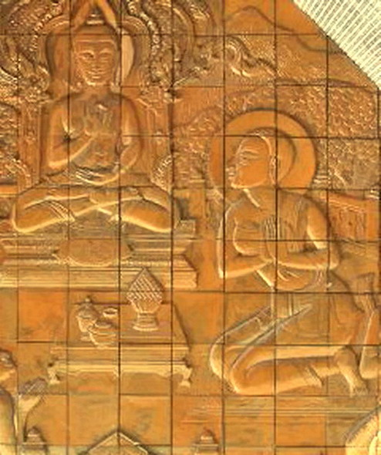
The Seven Sisters
Notes:
The foundation of these sisterhoods have their beginnings in the earliest stories of Buddhist women, from even before the birth of the Buddha, especially with the stories of the Seven Sisters. The Story of the Seven Sisters is a story of Spiritual Friendship and Companionship that lays the foundations for the early Buddhist Sangha, and for today’s bhikkhuni sanghas.
Today they have been largely forgotten, and have been unknown to the West. Now, these leading Seven Sisters are being researched and brought to light. They are the subject of one chapter in the important new book edited and co-written by Alice Collette released this September: Women In Early Buddhism.

Slide 7
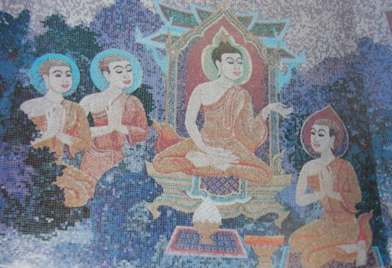
Bhikkhunis Listening to a Dhamma Teaching
Notes:
Of the forty women's sacred biographies in the Theri Apadana, the majority are of individuals. There are also a significant number of collective biographies -- women who had strong association with one another and are often known by the leading woman who drew them together. Their association was strong that they realized stages of awakening together during the same Dhamma teaching and/or declared their enlightenment to the Buddha together, causing their stories to be gathered into one collective voice.

Slide 8
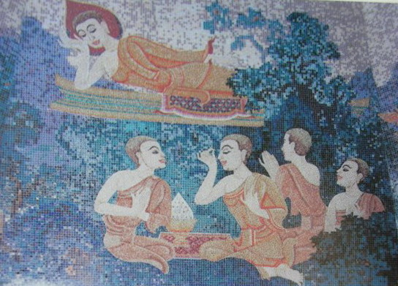
Early Sisterhood
Notes:
Of the individuals, seven of the forty -- a full half of the Thirteen early foremost leading Bhikkhuni Disciples of the Buddha -- are linked in a story-cycle or story-circle of long-term spiritual friendship and companionship known as the stories of the "Seven Sisters". These Seven Sisters, (earlier womb-sisters, but later sangha sisters in their final lives), formed the backbone of the ancient women's sangha. They include both the Two Foremost Leading Bhikkhuni Disciples: Khema of Great Wisdom and Uppalavanna of Great Spiritual Power.

Slide 9
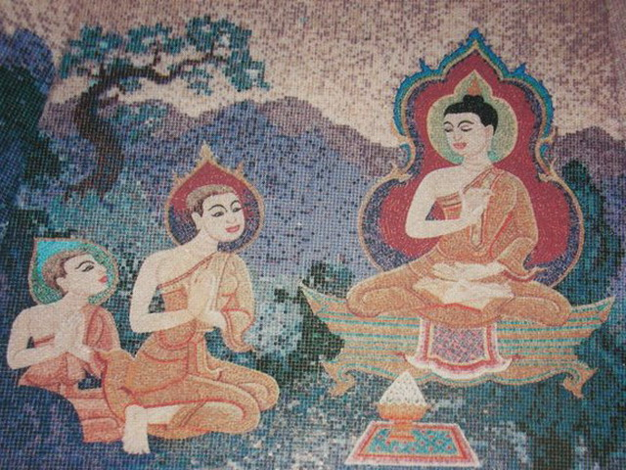
‘Womb’ Sisters and Sangha Sisters
Notes:
How were the seven sisters both ‘womb’ sisters in their earlier lives and finally ‘sangha’ sisters in their final lives? The story of the Seven Sisters actually begins 20,000 years ago, in the previous lives of the Seven Sisters, who at that time were actually birth sisters. They were reborn again in the time of Gautama Buddha, unrelated, through their connection with the Buddha, they became Sangha sisters.
9

Slide 10
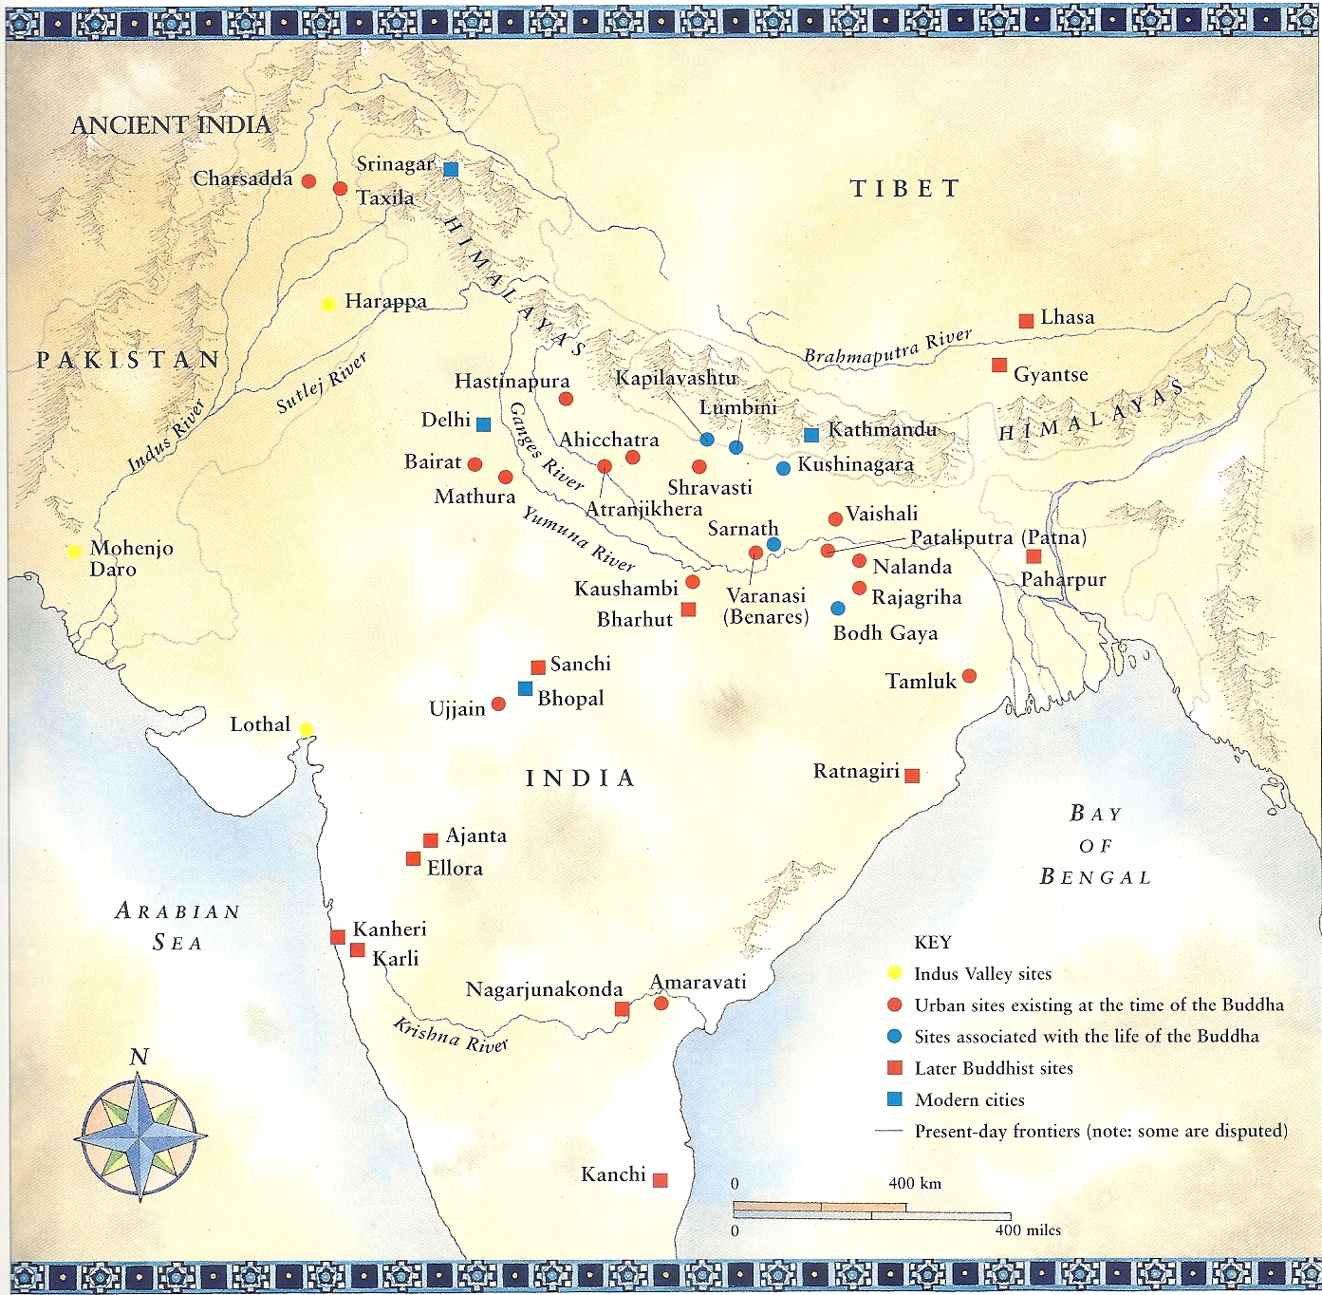
Sites associated
with the life of
The Buddha
“Buddhism”, Kevin Trainor, Ed.
Notes:
In that earlier era, a Brahman kinsman of great fame was born named Kassapa. Buddha Kassapa was one of many brahmins known as buddhas before Gotama Buddha. In the time of this earlier Buddha, in Kasi, in the great spiritual region of Varanasi, India there lived a king named King Kiki.
10

Slide 11
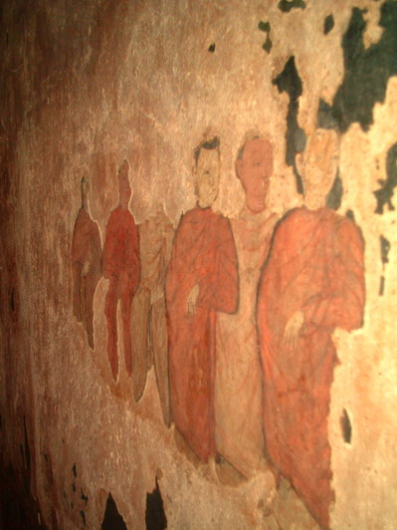
King Kiki of Kasi had Seven Daughters
Khema
Uppalavanna
Patacara
Bhadda Kundalakesa
Kisagotami
Dhammadinna
Visakha
Notes:
King Kiki had seven daughters, later named Khema, Uppalavanna, Patacara, Bhadda Kundalakesa, Kisagotami, Dhammadinna, and Visakha.
11

Slide 12
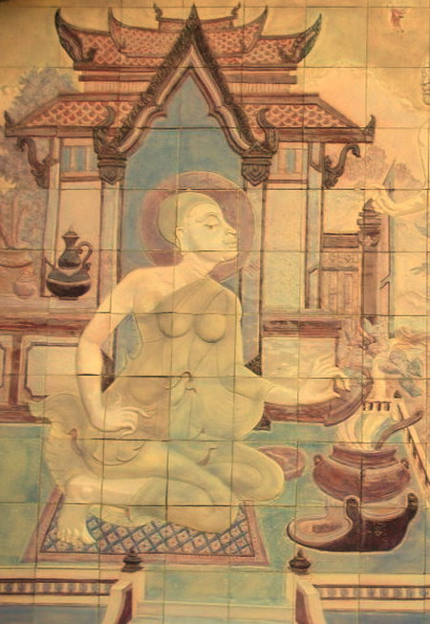
Khema Wishes to “Go Forth”
Notes:
In this previous life, his first daughter, Khema, wanted “to go forth”, to begin the path to become a fully-ordained monastic, a Bhikkhuni or Bhikkhu. However, her father denied her request. King Kiki had six more daughters. They too wanted to become monastics but were denied by their father, King Kiki. The Seven Sisters practiced a holy life at home for 20,000 years and countless reincarnations.
Ayya Tathaaloka compares this with the modern day. “Does this story sound familiar to you? How many millions of women have lived and are living this story today in South and Southeast Asian Theravada Buddhism? They are told by the king figures (whether sangha-raja or government) and father figures, that this is all they can do and such a future in another life is where they should invest their merit and efforts.

Slide 13
Theri-Apadana, Pali source
Theri-Apadana attributes Khema to have said,
“Now, our father did not give permission, but we, though staying at home, lived the holy life for 20,000 years unwearyingly, remaining happily daughters of the King, devoted to serving the Buddha, seven daughters taking delight.”
Notes:
They were reborn in the time of Gautama Buddha, where they did become monastics, and attained enlightenment.
13

Slide 14

Enlightenment of the Buddha
Notes:
Now we skip ahead to the time of Gautama Buddha. He seated himself under a bodhi tree in Bodh Gaya, India, where he vowed never to arise until he had found the truth. After a reputed 49 days of meditation, at the age of 35, he is said to have attained Enlightenment.

Slide 15

The Beginning of the Bhikkhuni Order
Notes:
What’s commonly told is the story that five years after his enlightenment, the Buddha was in Kapilavatthu at the Banyan Park Monastery. His aunt Maha-pajapati Gotami, who raised him, came to him with 500 women and begged to be admitted to the order of nuns. He at first refused.
Then Maha-pajapati Gotami and her 500 sisters shaved their heads, donned yellow robes and walked several hundred miles to Vesali to implore Sakyamuni Buddha for an "order of women mendicants.“

Slide 16
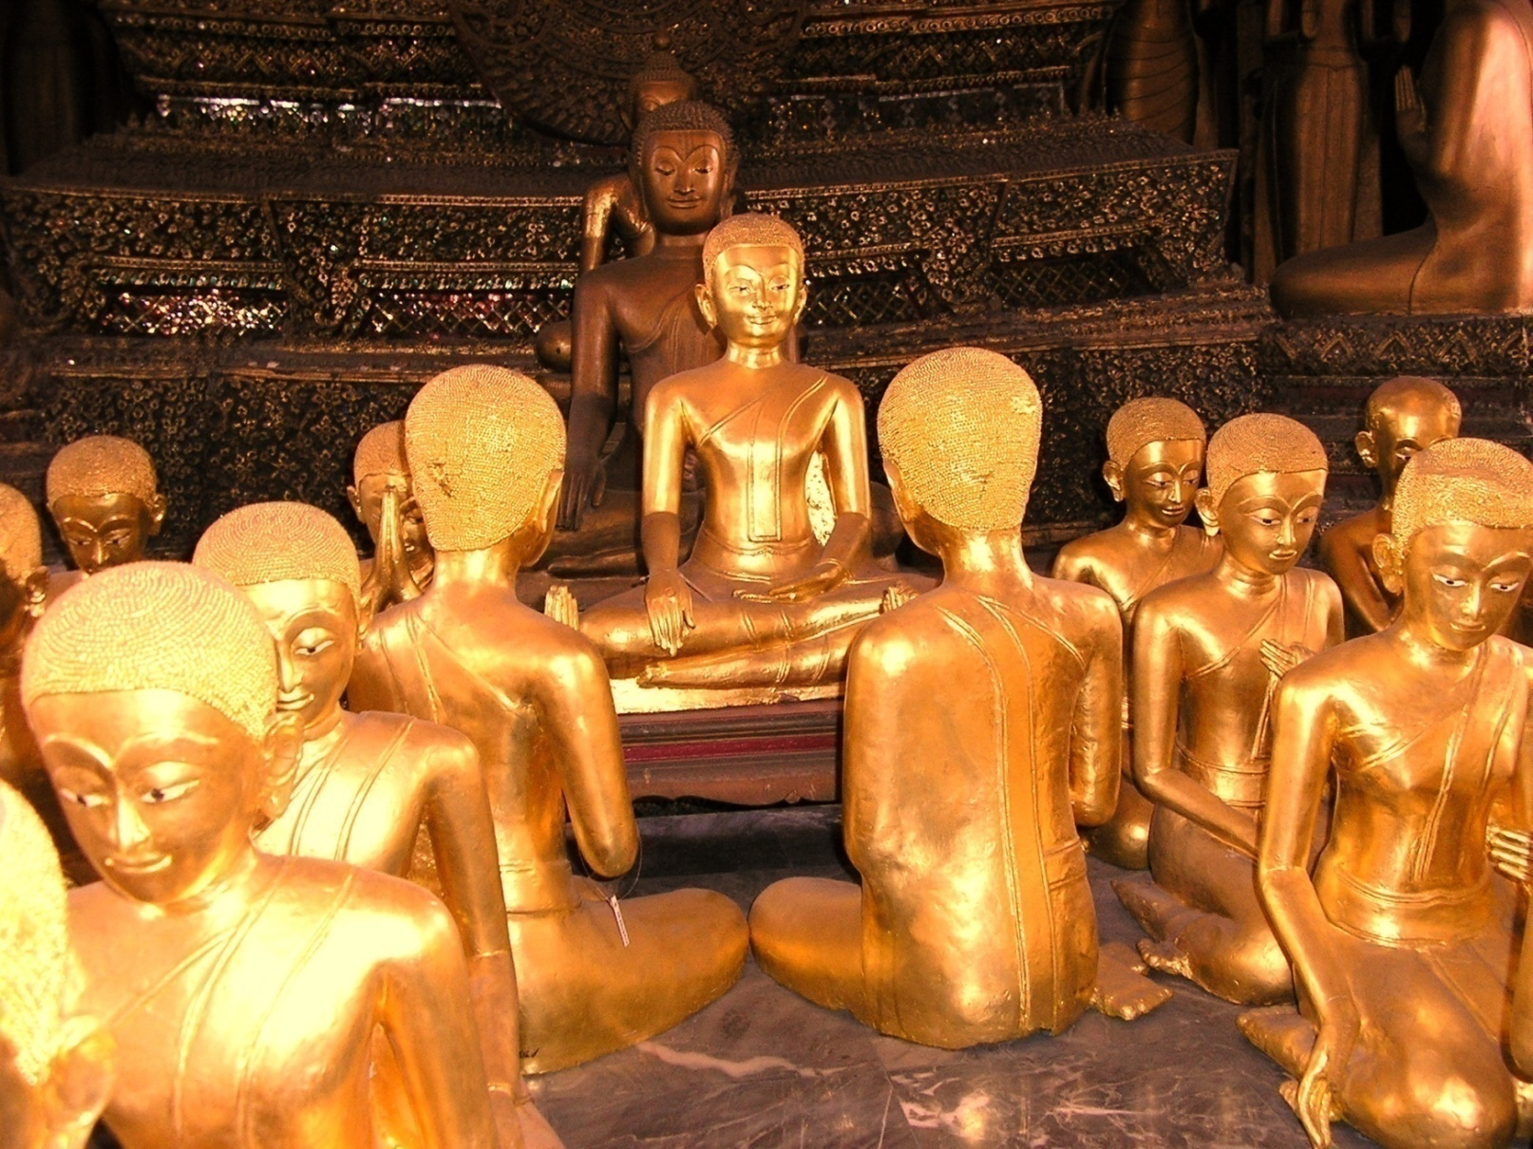
Mahapajapati Gotami and Fifty-two Bhikkhunis
Wat Thepthida-Aram, “Monastery of the Heavenly Daughter”, The Bhikkhuni Vihara, Bangkok, Thailand
Notes:
Ananda interceded on their behalf and convinced the Buddha to allow them to ordain, saying to the Buddha:
“Lord, if women were to go forth from the home life into homelessness in the Tathagata’s Dhamma-Vinaya, would they be able to realize the fruit of stream-entry, once-returning, non-returning, or arahantship?”
“Yes, Ananda, they would…….” (Cullavagga)
The Buddha agreed that the spiritual potential of women and men is equal, and he recognized the right of women to wear the garb of a mendicant.

Slide 17
The Buddha Establishes the Bhikkhuni Order
One thing that is well documented is the Buddha’s statement in the Cullavagga, “I allow, Oh Bhikkhus, Bhikkhunis to be ordained by you.”
This was the beginning of the Bhikkhuni order in India.
Notes:
According to the Cullavagga, the Buddha himself ordained the first Bhikkhuni (that is, Mahapajapati.) He also gave permission for Bhikkhus to ordain the remainder of the first several hundred bhikkhunis.

Slide 18
The Fourfold Sangha
The Buddha also said: “I will not pass away…until I have bhikkhu disciples...bhikkhuni disciples...layman disciples… laywoman disciples who are accomplished, disciplined, skilled, learned, expert in the Dhamma.”
From the Mahaparinibbana Sutta (“The Discourse on the Great and Final Passing of the Buddha”).
Notes:
Before he died the Buddha said: “I will not pass away…until I have bhikkhu disciples...bhikkhuni disciples...layman disciples… laywoman disciples who are accomplished, disciplined, skilled, learned, expert in the Dhamma.”
This is known as the Four-fold Sangha. With the foundation of the Bhikkhuni Sangha, the foundation of the buddha’s Fourfold Sangha was complete.
18

Slide 19
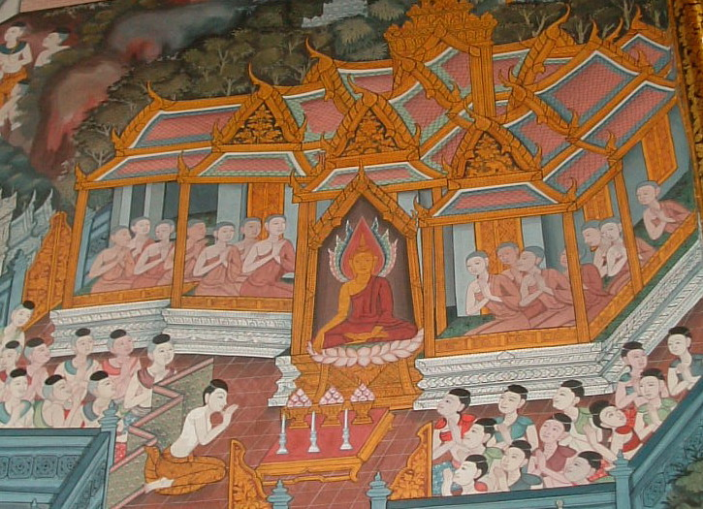
The Four Fold Sangha
The four-fold society consists of
bhikkhus and laymen (shown on the Buddha’s right) & bhikkhunis and lay women (on his left.)
Mural of the Four Fold Sangha
The Thirteen Great Arahant Bhikkhuni Disciples’
Wall, Wat Pho, Bangkok, Thailand
Notes:
At one point the Buddha, early in his teaching career, was questioned about the efficacy of his teachings. He affirmed that he had 500 Arahant bhikkhus and 500 Arahant bhikkhunis.

Slide 20
Many Enlightened Bhikkhunis
The Thirteen Great Arahant Bhikkhuni Disciples’ Wall, Wat Pho, Bangkok, Thailand
Notes:
The Buddha spoke very positively about having many enlightened bhikkhunis in his Assembly, saying that their presence made his Sasana (teaching) established and his purpose in teaching complete. Among them were our Seven Sisters, having been reborn into this time.

Slide 21
Seven Sisters At the time of Our Buddha
Khema – “Foremost in Great Wisdom”
Uppalavanna – “Spiritual Power”
Patacara – “Vinaya/Discipline”
Bhadda Kundalakesa – “Speed to Gain Awakening”
Kisagotami – “Ascetism”
Dhammadinna – “Dhamma Teaching”
Visakha – “Support of the Sangha”
Notes:
These Seven Sisters were not all the same, each one was a unique and special individual unto herself, and they are all praised by the Buddha for different excellent qualities that they bring to their own practice of the Path and to the Sangha. These are the qualities they became known for.
21

Slide 22
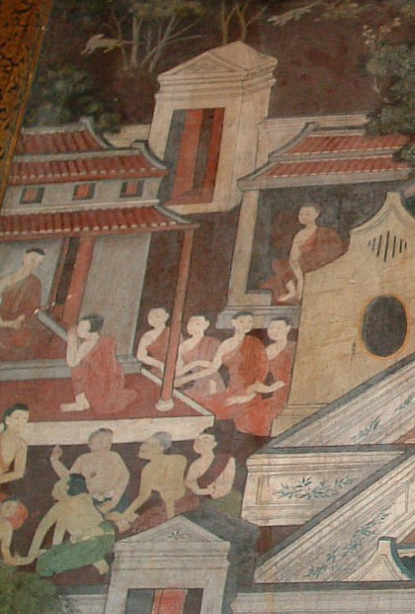
Bhikkhuni Requesting Ordination from the Bhikkhu Sangha, Wat Po mural, Thailand
Thirteen Great Arahanta Bhikkhuni Disciples Wall, Wat Pho, Bangkok, Thailand
Notes:
There are many stories of the Seven Sisters, too many to present all of them here, so we’ll just look at a couple of the stories. A new book by Dr. Alice Collett of York University in the UK has details of their lives, and how most of the them became bhikkhunis.

Slide 23

Seven Sisters
An Arahant is one who has ended all hatred, craving, delusion and ignorance in themselves, and will never give rise to their suffering for self or other again.
Notes:
The Seven Sisters were highly important and leading figures in early Buddhism and their stories have meaning for us today. All seven became disciples of Gotama Buddha. Not all became bhikkhunis, but all attained arahantship.
Who were some of these Eminent Leading Female Disciples of Gotama Buddha who lived 2,600 years ago and became Bhikkhunis, teachers and prominent leaders?
23

Slide 24
Story of Khema in the Time of Gautama Buddha
Notes:
Khema was very beautiful and became “intoxicated” with her own physical beauty. She knew the Buddha found fault with this, as the Buddha taught that it is ignorance to delight in sensory pleasures. Khema's husband, King Bimbasara, was a follower of the Buddha and was rueful of his wife's preoccupation with her beauty. He arranged for Khema to cross paths with the Buddha. The Buddha, sitting in the woods, knows Khema is coming and creates an apparition of a stunningly beautiful woman who was fanning him.
When Khema sees the Buddha and this stunningly beautiful female apparition she says, “Women of such beauty, comparable to heavenly nymphs, stand near the Blessed One. I am not adequate even to be an attendant to her.”
The Buddha then transforms the apparition into a decrepit old woman, her hair gray and teeth all loose and broken. Khema, upon seeing the shocking transformation, realizes the truth of impermanence, that beauty is only temporary Khema asks her husband for permission to go forth and he gives it.
24

Slide 25
Khema on Impermanence
“Those who are slaves to desire are caught in its current like a spider in its self-made web.
Those who have severed this go forth, free from longing, abandoning the pleasure of desire.”
(Collett, Pali biographies)
Notes:
In her teaching, Khema is said to have passed on to others what she had learned.
25

Slide 26
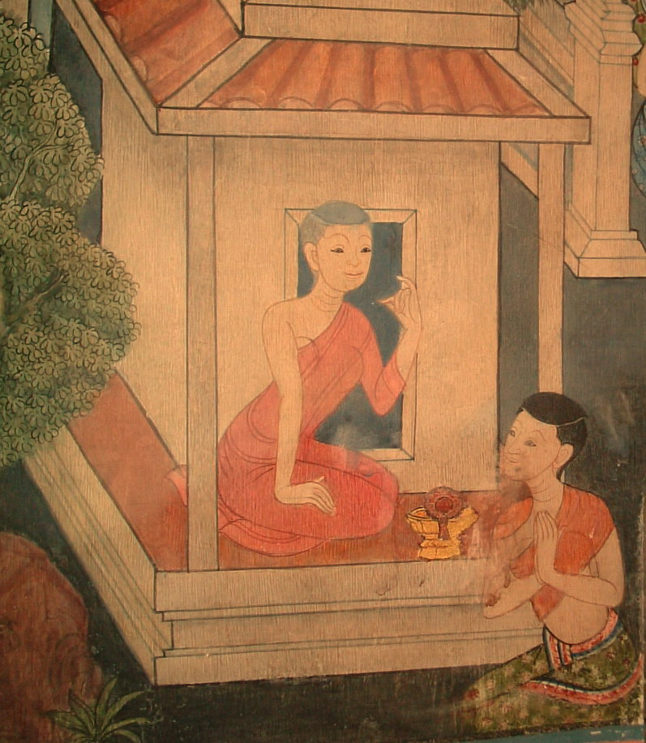
Ayya Khema
Proclaimed by the Buddha as Foremost in Wisdom
Notes:
The Buddha proclaims Khema to be the foremost in wisdom. Khema becomes the first chief female disciple, one of great wisdom, one of the first of the bhikkhunis in a leadership role.
26

Slide 27

Uppalavanna Was Known for Her ‘Spiritual Power’
Queen’s Monument to the Enlightened Women in the Sangha,
Doi Inthanon, Chiang Mai, Thailand
Notes:
He recommended Ayya Khema and Uppalavanna, co-leaders of the Bhikkhuni sangha, as exemplars, for others to emulate. Uppalavanna became known for her ‘Spiritual Power’.

Slide 28
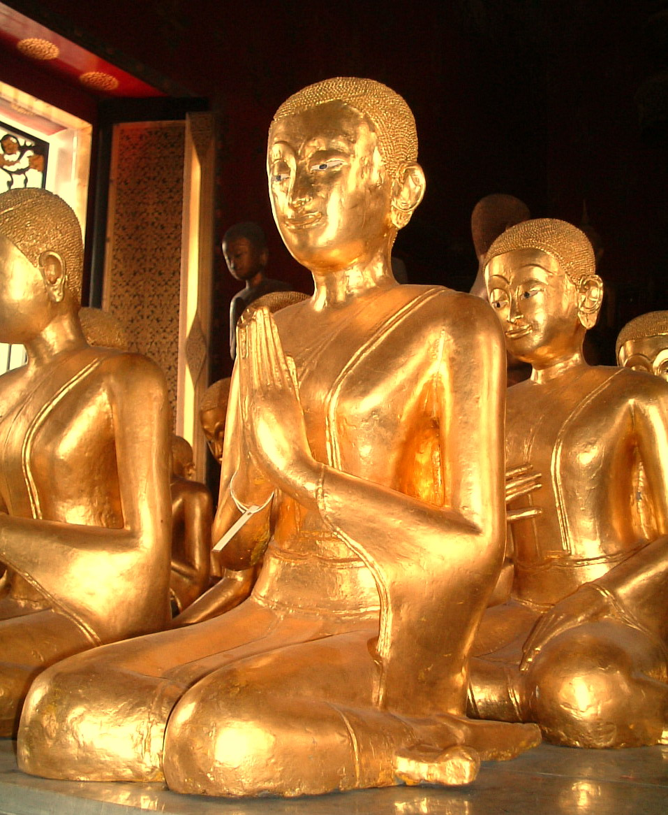
Arahant Bhikkhuni Dhammadinna
Notes:
Arahant Dhammadinna was known for he ‘Dhamma Teaching’. The Buddha said that Arahant Bhikkhuni Dammadinna’s teaching was as “the Buddha's word”, equating it to his own.
28

Slide 29
Patacara Learns about Impermanence
“Going along, about to bring forth, I saw my husband dead; having given birth on the path, I had not yet arrived at my own house….
Two sons dead, and a husband dead upon the path for miserable me; mother and father and brother were burning upon one pyre.
Then I saw the flesh of my sons being eaten in the midst of the cemetery.”
Patacara in the “Therigatha”
Notes:
Patacara’s story is often told. She suffered terrible losses, losing her husband, parents and her children. With the death of one of her children, perhaps so overcome with grief that she is unstable, the grieving mother takes the corpse of her dead infant in her arms going around the town seeking medicine for dead child. A friend leads her to the Buddha where she requests him to give her medicine for the child. He sees that she has the potential for significant religious attainment and tells her to fetch a white mustard seed from each house in the town in which no death has occurred. After going from house to house for a number of houses, she realizes that, in truth the dead are more numerous than the living, and that everyone is touched with by death. She is finally able to lay the corpse of her child to rest. She returns to the Buddha and tells him she has learned the nature of impermanence and requests ordination from the Buddha.

Slide 30
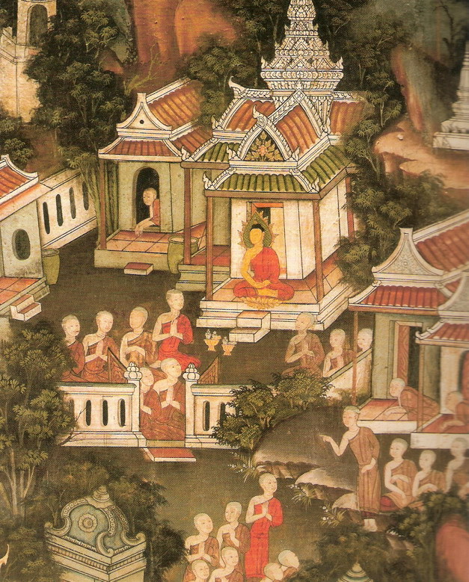
Patacara joins the bhikkhuni community
Great Bhikkhuni Disciples with the Buddha, Wat Po Vihara Mural, Bangkok, Thailand
Thirteen Great Arahanta Bhikkhuni Disciples Wall, Wat Pho, Bangkok, Thailand
Notes:
Patacara goes to live in the nun’s community and quickly attained arahantship. She became a prominent bhikkhuni and was known for her discipline and practice of the Vinaya.

Slide 31
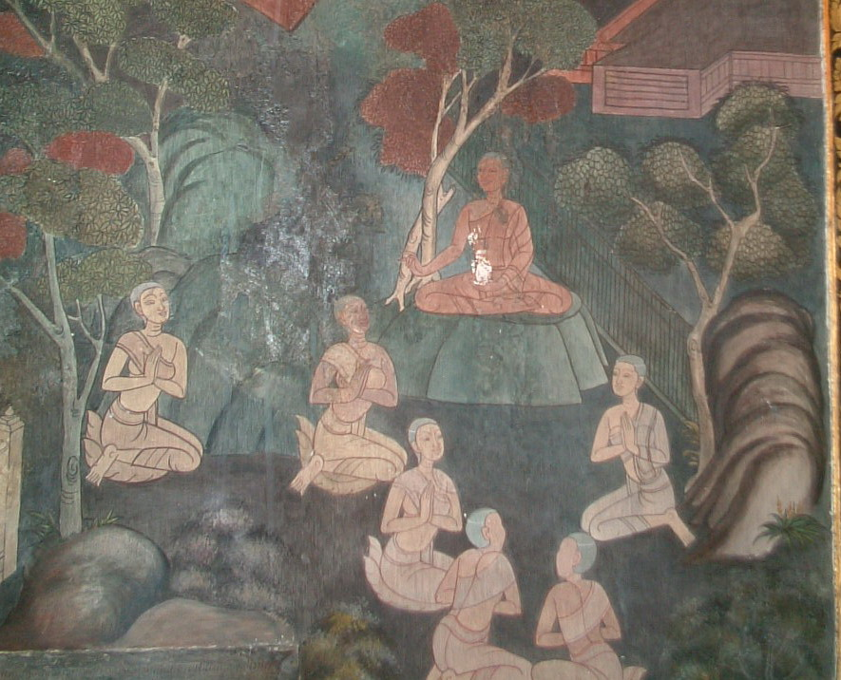
Sisterhoods Past and Present
Requesting the Pabbaja from the Bhikkhuni Sangha
Thirteen Great Arahanta Bhikkhuni Disciples Wall, Wat Pho, Bangkok, Thailand
Notes:
Why are the Seven Sisters important to us today? The Story of the Seven Sisters is a story of Spiritual Friendship and Companionship that lays the foundations for the early Buddhist Sangha. It is a story of the making of Leaders -- specifically Women Leaders -- who offer great benefit to all of Buddhism. They also serve as models and mentors for current bhikkhuni teachers and leaders.

Slide 32
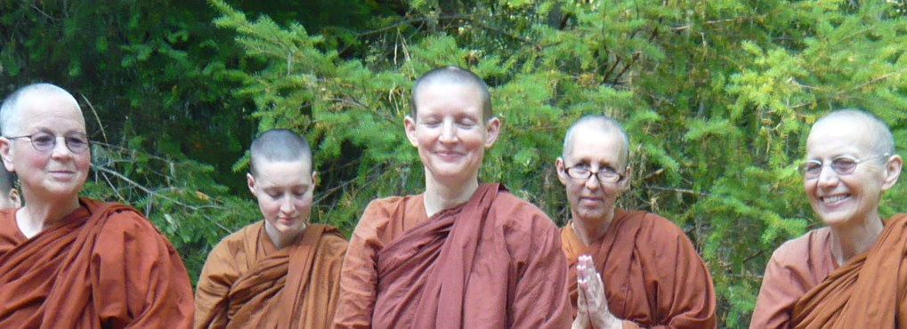
Spiritual Companionship
Sobhana Bhikkhuni, Nibbida Bhikkhuni, Tathaaloka Bhikkhuni,
Santacari Samaneri, Suvijjana Bhikkhuni
Notes:
Ayya Tathaaloka writes: “Their stories are inspiring to me because they relate directly to my own experience of spiritual companionship today. The heroines are both laywomen and monastics, and sometimes (as in the "sisters refrain") something in between. Their stories of companionship bridge the entirety of their time on the path in its many incarnations and many forms of being in their lives.”

Slide 33
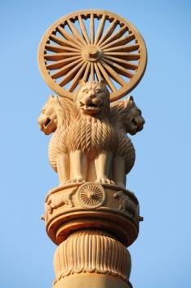
One of the many pillars erected by Emperor Asoka
Bhikkhuni Order in India
By the time of Emperor Asoka (304-232 BCE), a convert to Buddhism, the orders of bhikkhus and bhikkhunis were well established in India.
Notes:
So how did we get from these earlier sisters in the time of the Buddha to the current Bhikkhuni Order? Here is a quick history of bhikkhunis. (More details can be found on our website www.bhikkhuni.net, on previous power point presentations or in articles on the Library and Present connections.)

Slide 34

The Bhikkhuni Sangha in Sri Lanka
Emperor Asoka sent his son, Mahinda and daughter, Sanghamitta to Sri Lanka in the 3rd century BCE to spread Buddhism.
Notes:
In India, Emperor Asoka, having been a merciless king, at the intersession of a Buddhist monk, eventually saw the carnage he had wrought and became a Buddhist. He sent his son, Mahinda, and daughter, Sanghamitta, to Sri Lanka in the 3rd century BCE to spread Buddhism.
Arahanta Bhikkhuni Sanghamitta, Asoka’s daughter, arrived from India with a Bo Tree cutting, welcomed by the King (Devanampiyatissa.) Bhikkhuni Sanghamitta ordained Queen Anula, a woman in the king’s court, among many other women. Emperor Asoka also sent missionary bhikkhus and bhikkhunis into the “Land of Gold”, the region now known as Southeast Asia, Burma, Thailand, Laos and Cambodia. Centuries ago scholars believe there were many bhikkhunis in Thailand.

Slide 35
Bhikkhuni Sangha Spreads to China
In 429 CE, Bhikkhuni Devasara traveled from Sri Lankan to China
Notes:
In 429 CE, Bhikkhuni Devasara, a Sri Lankan bhikkhuni, took a cutting from the Sri Lanka tree grown from a cutting from the Indian Bodhi Tree and traveled to China with a quorum of bhikkhunis to establish a dually-ordained branch of the Bhikkhuni Sangha there. These Sri Lankan bhikkhunis gave higher ordination to more than 300 Chinese nuns at a monastery in Nanjing. Until then, bhikkhunis in China had been ordained by the Bhikkhu Sangha alone or had remained as samaneris. This was a great example of trans-national and trans-sectarian sisterhood and cooperation for the enormous benefit of Buddhism. A second group followed in 433 CE.

Slide 36
Sri Lankan Bhikkhunis Establish Unbroken Bhikkhuni Lineage
Notes:
China’s bhikkhuni lineage has continued to the present day in an unbroken upasampada (ordination) lineage. The bhikkhuni tradition also spread to Vietnam, Korea , Japan and finally Taiwan. There are now thousands of Taiwanese, Korean, Vietnamese, and Chinese bhikkhunis. This unbroken lineage became very important about 1500 years later, as we shall see, when the Mahayana bhikkhunis from these orders were able to help their Theravada sisters revive their Sangha.
36

Slide 37
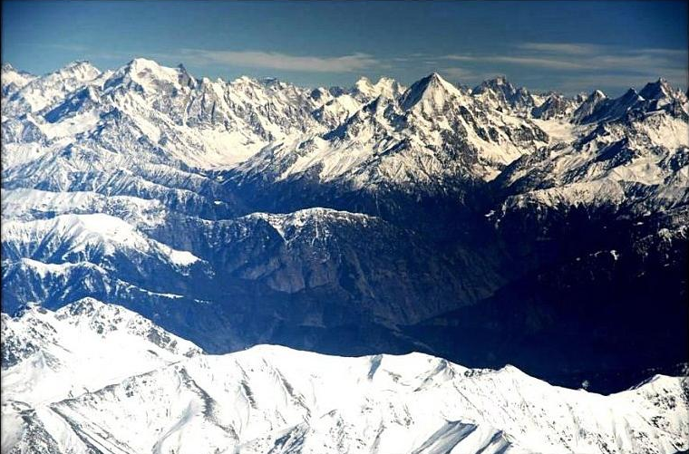
One Major Thing Prevented the Spread of the Bhiksuni Order to Tibet
Notes:
The bhikshuni lineage was also not established in Tibet due to the difficulty in crossing the Himalayas. While there are a few historical records of a few bhikshunis in Tibet receiving their ordination from the bhikshu sangha alone, it never took hold in Tibet, because a sufficient number of Indian bhikshunis did not go to Tibet, nor did sufficient number of Tibetan women go to India to take ordination and return to Tibet to be able to pass it on to others.
37

Slide 38
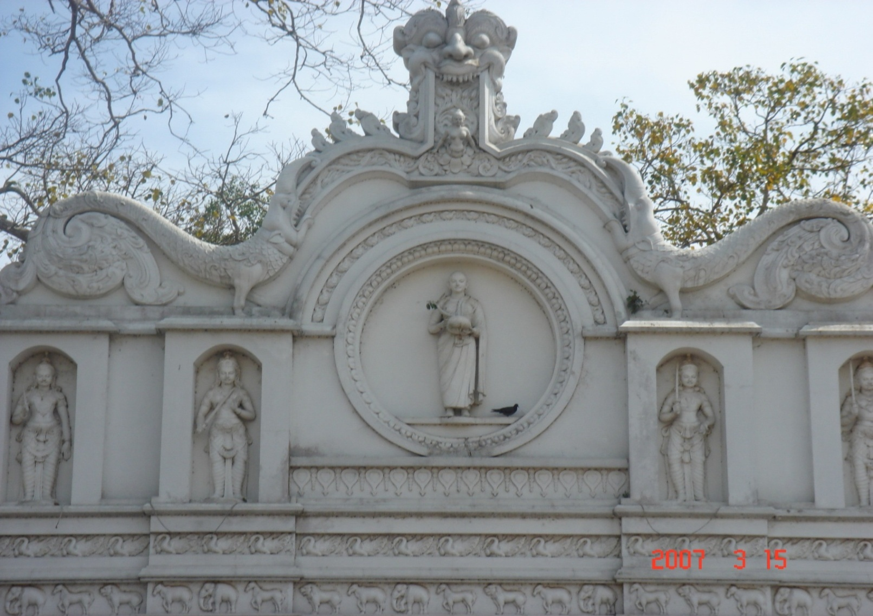
Bhikkhuni Sangha Disappeared in India and Sri Lanka Both Bhikkhu and Bhikkhuni Sanghas died out in India and Sri Lanka after the 15th century
Sanghamitta Shrine, Kelaniya, Sri Lanka
Notes:
Because of political upheavals and religious persecution, both the Bhikku and Bhikkhuni Sanghas died out in India and Sri Lanka. The last records we have of bhikkhunis in South India are from the 15th century, right up to the beginnings of colonialization.

Slide 39
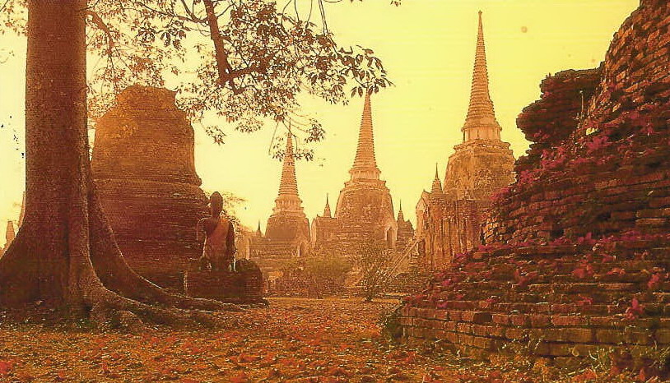
Ayutthaya Historic Park, the ancient Thai Capital
Bhikkhu Sanghas of South, Southeast and East Asia have been revived multiple times, but the Bhikkhuni Sanghas of Sri Lanka and Southeast Asia were not revived at the same time.
Notes:
While the Bhikkhu Sanghas of South, Southeast and East Asia have been revived multiple times, the Theravada Bhikkhuni Sangha was never revived, at that time. In fact, in 1928, the Thai Bhikkhu Sangha decreed that the bhikkhuni lineage had died out and could not be revived. Thai bhikkhus to this day are prohibited from ordaining women. As recently as the late 1990’s, there were no bhikkhunis in Sri Lanka or Thailand.
Similar laws were also passed in Burma. As recently as 2005 a Burmese bhikkhuni, Ayya Saccavadi, who had ordained in Sri Lanka with Ayya Gunasari, went back to Burma to visit her dying father. She was arrested and jailed for “impersonating a monk”, jailed in harsh conditions (including threats or rape) and sentenced to five years in jail. She was released through the intervention of her family and after her story was carried on BBC, if she agreed to leave their country. She came to the US and lived with Ayya Gunasari at Mahapajapati. Suffering from her traumatic experiences she disrobed in 2008 and has settled near Mahapajapati Monastery in Joshua Tree. (You can read her story online if you Google her name.)
39

Slide 40
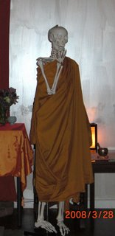
I’ve been waiting for
bhikkhuni ordination
for such a long time…
From Santi Forest Monastery Website
Notes:
A little bhikkhuni humor.
40

Slide 41
How did the Current Theravada Bhikkhuni Order Revive?
Notes:
So how did the Theravada bhikkhuni order revive.

Slide 42
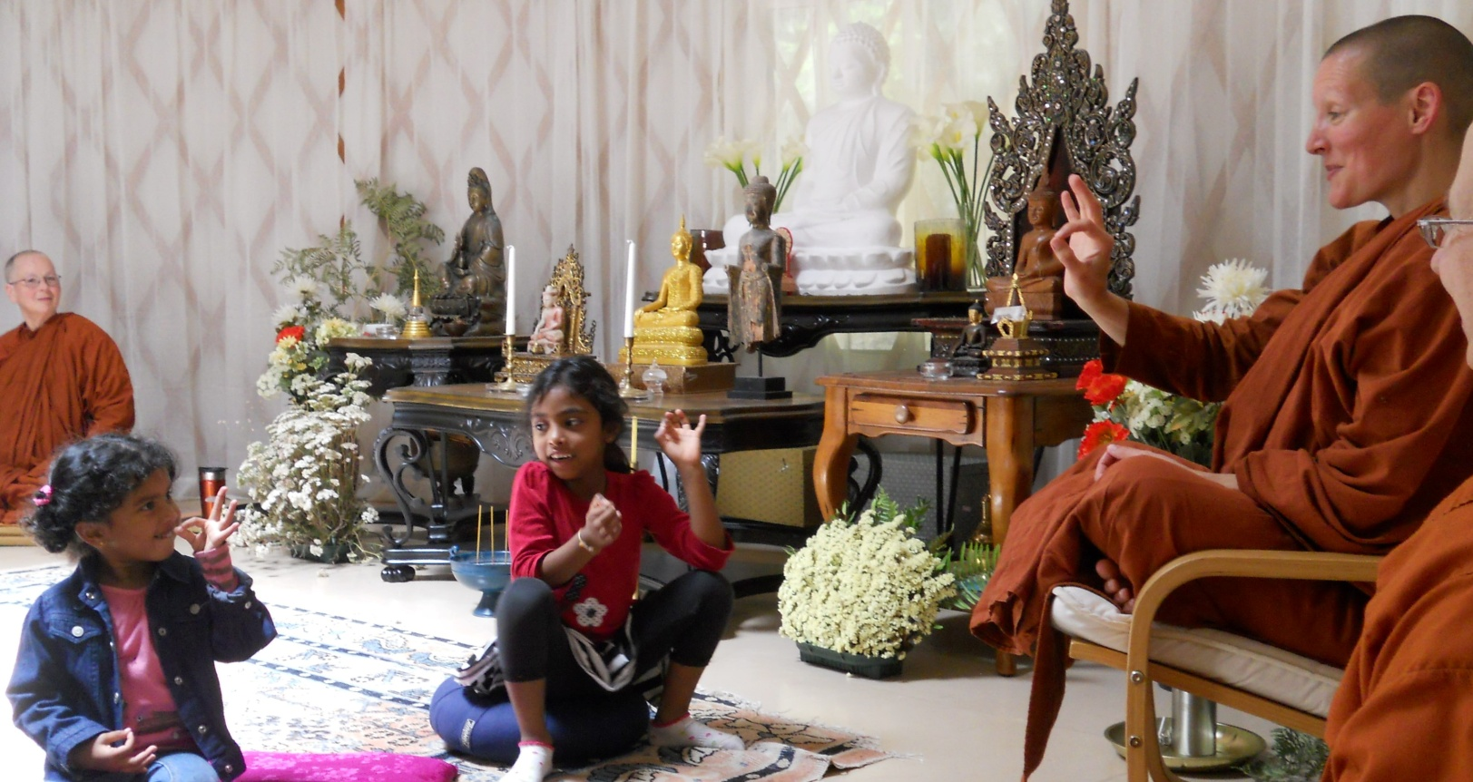
And who are some of the current pre-eminent bhikkhuni leaders and teachers?
Notes:
Following is a chronological history of the revival of the current bhikkhuni/bhikksuni sanghas and some of the outstanding and courageous women who are part of that history.

Slide 43
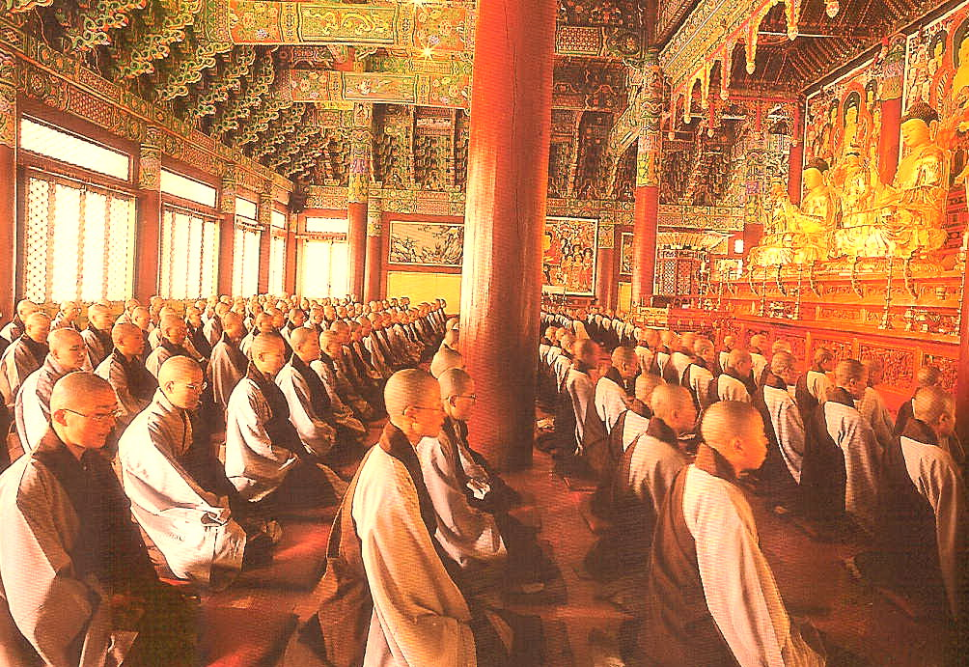
Mahayana Bhikshunis Helped Revive the Bhikkhuni/Bhiksuni Sanghas in the Theravada & Tibetan Traditions
Unmoonsa Bhikkhuni Training Monastery & Sangha College, South Korea
Notes:
In part bhikkhuni and bhiksuni orders around the world owe a debt of gratitude to their Mahayana sisters. You remember that 1500 years ago Sri Lankan bhikkhunis carried the bhikkhuni order to China, and hence to Korea and Taiwan. Over the centuries Bhikkhuni orders thrived in these countries.
In recent years these Mahayana sisters, along with supportive monks, have been able to ordain women who practice in both Theravada and Vajrayana (Tibetan) tradition. There are now over 1000 bhikkhunis in Sri Lanka and about 50 bhikkhunis or samaneris in Thailand. Many Thai women traveled to Sri Lanka to ordain, back to where Sanghamitta Bhikkhuni started her sangha.
43

Slide 44
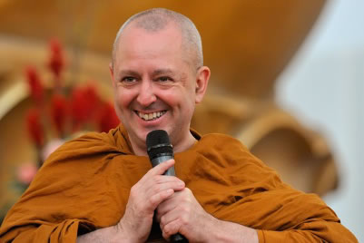
East Asian Dharmaguptaka ordination procedural text is almost identical to Southeast Asian Pali-text ordination procedure
“In all the Mahayana schools whether in Tibet, China, Korea, or Vietnam, they follow mostly a Dharmagupta Vinaya. Dharmagupta is one of the old Theravada sects. ”
Ajahn Brahm
Notes:
When this began some Theravadin monks questioned the validity of this ordination. However, Ajahn Brahm’s, who has been a great supporter of bhikkhunis, says that his research shows that they are almost identical.
He said, "One of the biggest myths is that bhikkhunis under the Mahayana tradition is somehow separated from the Theravada. But the truth of the matter is, there is no such thing as a Mahayana Vinaya. In all the Mahayana schools whether in Tibet, China, Korea, or Vietnam, they follow mostly a Dharmagupta Vinaya. Dharmagupta is one of the Theravada sects. If you see an ordination ceremony in Taiwan – I saw a video of one that was recently conducted - you’d see the similarity. I had a copy of the chanting. It was almost identical with the ordination ceremony which is done say in Wat Bovorn here in Bangkok .”
44

Slide 45
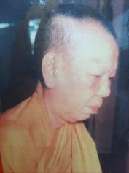
Bhikkhuni Tao Fa Tzu
First Thai woman to become a bhikkhuni in the 20th Century
1908 Born Voramai Kabilsingh Shatsena
1955 Ordained as a samaneri (10 precepts)
1971 Lacking full ordination in Thailand, she traveled to Taiwan for bhikkhuni ordination
Established Sondhammakalyani Temple outside of Bangkok
Notes:
Voramai Kabilsingh Shatsena, a Thai wife and mother, who had been married to member of parliament, began her monastic life by receiving the ‘Eight Precepts’ and lived as a maechee for 15 years.
-She was then ordained as a samaneri with the 10 precepts by an eminent Thai bhikkhu in a Wat in the royal residence.
-Since she could not be fully ordained in Thailand, she traveled to Taiwan to ordain as Venerable Ta Tao Fa Tzu.
-She established Sondhammakalyani Temple outside of Bangkok on land purchased by the Queen, published a Buddhist monthly magazine for 32 years and was very involved with social welfare.
Her daughter, Ven. Bhikkhuni Dhamananda, was the first Thai bhikkhuni ordained in the Theravada tradition. “Venerable Grandma”, as she was known died in 2003.
45

Slide 46
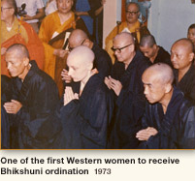
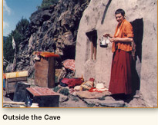
Bhiksuni Jetsunma Tenzin Palmo
1963 Left London for India to study Buddhism
Second Western women to receive novice ordination (shramanerika)
Lived in a remote cave in the Himalayas for 12 years
1973 Received full bhiksuni ordination in Hong Kong
2000 Established Dongyu Gatsal Ling Nunnery in the Himalayas
Notes:
Bhiksuni Tenzin Palmo was one of the first Westerners ordained as a bhiksuni. She received full ordination in Hong Kong in 1972. She lived for 12 years in a remote cave in the Himalayas, recounted in her book, “Cave in the Snow”. She established a Nunnery in the Himalayas to train women.
46

Slide 47
Bhiksuni Pema Chodron
Born in NYC in 1936
Graduated form UC Berkeley
Elementary school teacher for many years
In her mid-thirties traveled to the French Alps where she met Lama Chime Rinpoche
Ordained as a novice in 1974
1981 fully ordained in Chinese lineage in Hong Kong
Currently abbess of Gampo Abbey in rural Cape Breton, Nova Scotia
Author of many books on Buddhism
Notes:
Bhiksuni Pema Chodron was fully ordained in 1981 fully in Chinese lineage also in Hong Kong. She is currently abbess of Gampo Abbey in rural Cape Breton, Nova Scotia and it the author of many books on Buddhism.
47

Slide 48
Bhiksuni Karma Lekshe Tsomo, Ph.D.
1982 Fully ordained in South Korea
1986 Established Jamyang Foundation for the education of Himalayan nuns
1987 Co-founded Sakyadhita (Daughter of the Buddha) International Association of Buddhist Women
2000-present Associate Professor, Theology & Religious Studies, USD
-
Notes:
Raised in Hawaii, a surfing competition led her to Japan, which then took her to India. Compelled by the Tibetan culture & spirituality in Dharamsala, she stayed for a year. When money ran out, she sold her guitar back at home & stayed another year.
She was fully ordained in Mahayana tradition in South Korea in 1982.
She went on to co-found, with Ayya Khema, Sakyadhita (Daughters of the Buddha) International Association of Buddhist Women. Through her Jamyang Foundation in the Himalayas she has started a number of schools to educate Indian women. She also helped to establish the Sanghamitra Institute in Delhi. Most recently she was instrumental in orchestrating the visit of His Holiness the Dalai Lama to San Diego.
48

Slide 49
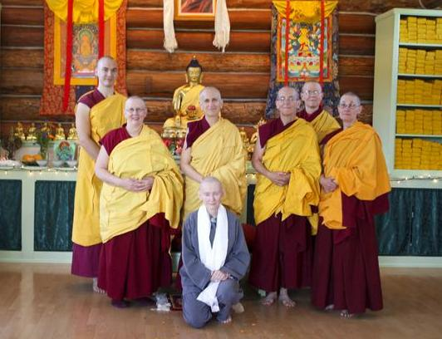

Bhiksuni Thubten Chodron
1971 B.A. History, UCLA
1977 Ordained as a nun in Dharamsala, India
1987 Full ordination in Taiwan
2003 Established Sravasti Abbey in Washington State
Notes:
Bhiksuni Thubten Chodrun was full ordained in 1987 in Taiwan and went on to establish the Sravastri Abbey in Washington State.
49

Slide 50
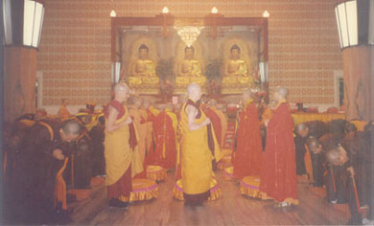
1998 International Full Ordination Ceremony in Bodhgaya, India
Bhikshunis-to-be pay respects to their
preceptors, Bhiksunis Thubten Chodron &
Karma Lekshe Tsomo
Notes:
Like Sanghamitta, the women who ordained earlier taught and ordained other women. In 1998, Bhiksunis Thubten Chodron and Karma Lekshe Tsomo ordained new bhiksunis at Bodhgaya, India.
50

Slide 51
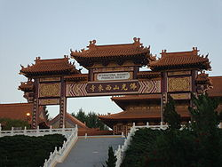
1988 –Five Sri Lankan ten-precept nuns (including Ayya Khema) were fully ordained as bhikkhunis at Hsi Lai Temple in Southern California by Taiwanese bhikshus and bhikshunis as supported by elder Sri Lankan bhikkhu Ven. Havenpola Ratanasara and the newly-founded Sakyadhita.
Notes:
In 1988 a group of Sri Lankan ten-precept nuns ordained at Hsi Lai Monastery in Hacienda Heights, Southern California. That group included Ayya Khema, Ven. Dharmapali (the first American bhikkhuni - now disrobed) and the first Nepalese Theravada bhikkhuni in modern times, Ven Dhammawati.
Sadly, without support, only Ayya Khema remained a bhikkhuni. (It was awareness of this situation that later inspired Susan Pembroke to found the Alliance for Bhikkhunis, to help support bhikkhunis, but more about that later.)
51

Slide 52
Ayya Khema (b. Berlin 1923 – d. Buddhahaus, 1997)
-1979 first Western woman to ordain as a Theravada samaneri .
-1987 co-organized the first international conference of Buddhist nuns, resulting in the founding of Sakyadhita.
-First Buddhist nun to address the U.N. in N.Y. in 1987.
-1988 fully ordained in the Chinese (Taiwanese)Hsi Lai Temple in Southern California
The inspiration for the creation of the Alliance for Bhikkhunis
Notes:
In 1979 Ayya Khema first ordained as a 10 precept nun in Sri Lanka, where she was active in restoring full ordination for women and setting up many training centers for nuns. Ayya Khema was fully ordained in a Taiwanese temple in Los Angles in 1988. Along with Bhiksuni Lekse Tsomo, she co-founded Sakyadhita. In 1987 she was the first Buddhist nun to address the UN.
52

Slide 53
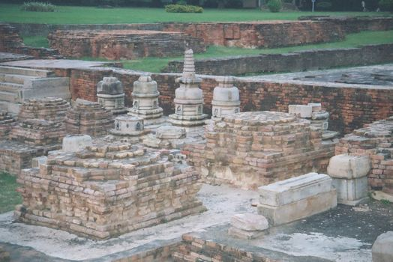
Theravada Bhikkhuni Sangha reestablished in Sri Lanka.
1996 – The Korean Bhikkhu & Bhikkhuni Sanghas and Sri Lankan bhikkhus sponsored another bhikkhuni ordination for 10 Sri Lankan dasasilmatas, including Ven. Kusuma and Ven. Sudarshana, in Sarnath, India.
Notes:
In 1996, Sakyadhita, along with South Korea & Sri Lankan monks organized and sponsored the first International higher ordination in Sarnath, India. At that time 10 Sri Lankan nuns received full ordination as bhikkhuni. Although it did not occur in Sri Lanka it reestablished the Bhikkhuni sangha in Sri Lanka
53

Slide 54

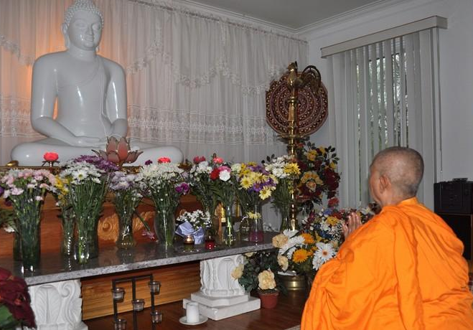
Bhikkhuni Kusuma
Bhikkhuni Kusuma was one of 10 Sri Lankan women ordained in 1996 in Sarnath, India. Now there now almost 1000 bhikkhunis in Sri Lanka.
Notes:
One of those Sri Lankan women was Ven. Bhikkhuni Kusuma MA. PhD. She has pioneered the re-establishment the Theravada Bhikkhuni Sangha in Sri Lanka and has taken upon herself the task of carrying on the efforts of her mentor, Ayya Khema, in establishing the 'Ayya Khema International Buddhist Mandir.
54

Slide 55
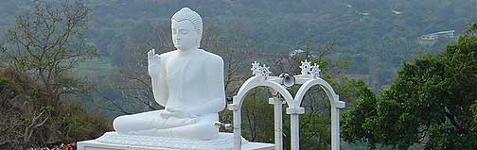
First Modern Bhikkhuni Ordination in Sri Lanka
2003 - First bhikkhuni higher ordinations in modern times on Sri Lankan soil.
American Bhikkhuni Ayya Sudhamma, Thailand’s Ven. Dhammananda, and Burmese born Ayya Gunasari & Ayya Saccavadi were ordained at this time.
Notes:
In 2003, Sri Lanka came full circle from the time the Sanghamitta first brought the bhikkhuni sangha to the island. The first bhikkhuni higher ordinations in modern times were held on Sri Lankan soil. Ordained at that time were American Ayya Sudhamma, and Burmese Ayya Gunasari and Ayya Saccavadi, as well as Thailand’s Venerable Dhammananda. Ayya Gunasari was the first Burmese and Ven. Dhammananda the first Thai woman to be fully ordained as a Theravada bhikkhuni in modern times. Ayya Sudhamma has the distinction of being the first American woman to be fully ordained in Sri Lanka. In this same year, Vietnamese Bhikkhuni Dhammananda also ordained but at Anuradhapura, Sri Lanka.
Many of the bhikkhunis went on to build the bhikkhuni sangha. Ven. Sudhamma became the first resident bhikkhuni teacher at the Carolina Buddhist Vihara, a Theravada Buddhist center in a small house in the suburbs of Greenville, SC. Ayya Gunasari is now the abbess of Mahapajapati Monastery near Joshua Tree, California. And Ven. Dhammananda is abbess of a monastery in Thailand (and the sculptor of the clay Sanghamitta image we saw earlier.)
55

Slide 56
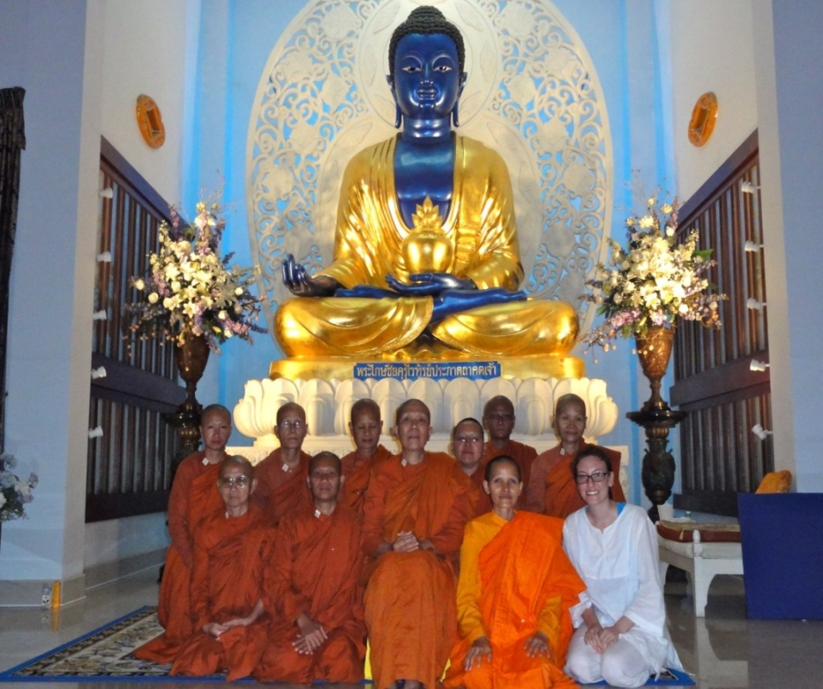
Bhikkhuni Dhammananda, Ph.D.
1945 Born Chatsumarn Kabilsingh in Thailand
(daugher of Bhikkhuni Tao Fa Tzu)
1975-2000 Professor of Buddhist philosophy at Thammasat University
2001 Received samaneri ordination
2003 Received full bhikkhuni ordination in Sri Lanka
Notes:
Ven. Dhammananda was the first Thai woman to ordain as a Theravada bhikkhuni. Her renowned mother Venerable Voramai ordained in a Taiwanese temple when Ven. Dhammananda was ten years old. Now abbess of the first of a growing number of bhikkhuni temples in Thailand. In 2013 she spearheaded the foundation of the Asian Bhikkhuni Association, established a sima for ordination in Southern Thailand and began construction of an international bhikkhuni conference center at her temple.
56

Slide 57
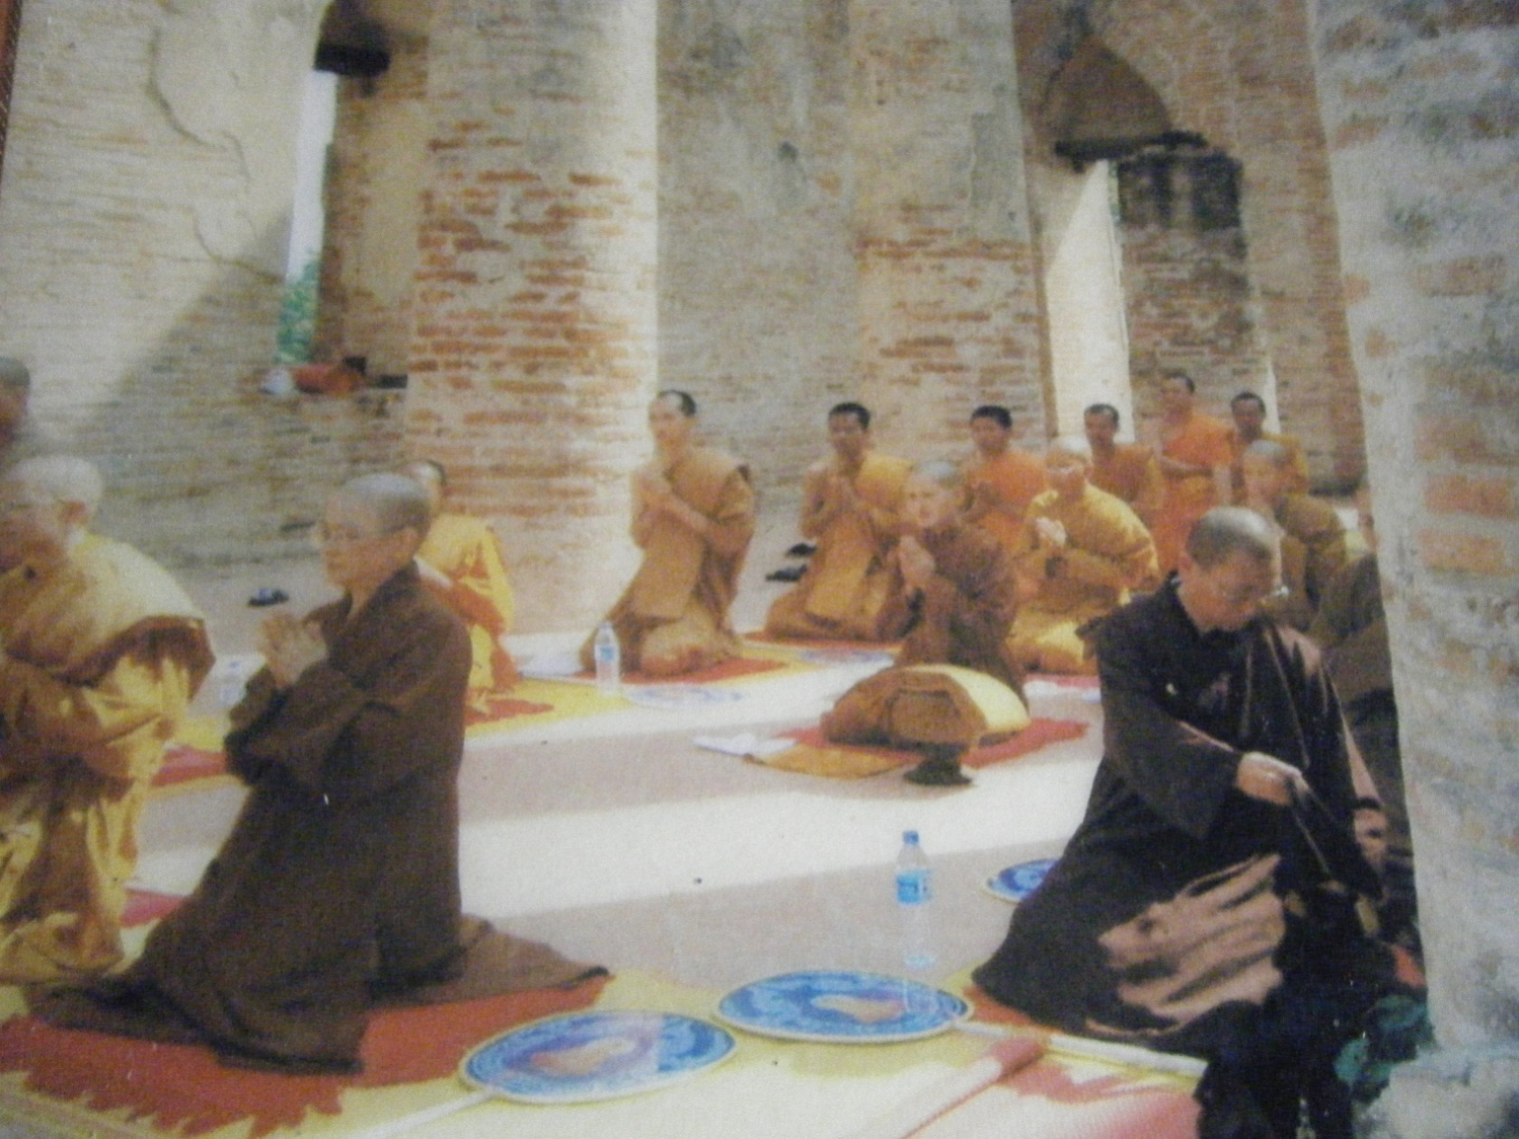
In 2006, in a secret ceremony in the ancient ruins at Ayutthaya in Thailand, three more Thai women ordained as bhikkhunis − Bhikkhunis Rattanavali, Dhammamitta, and Silananda.
Notes:
In 2006, in a secret ceremony in the ancient ruins at Ayutthaya in Thailand, three more Thai women ordained as bhikkhunis − Bhikkhunis Rattanavali, Dhammamitta, and Silananda. Bhikkhunis Rattanavali, Dhammamitta, and Silananda now have their own viharas and are well supported by lay people in their communities.
57

Slide 58
Ayya Tathaaloka
1968 Born in Washington, DC
Ordained as an anagarika, traveled & studied in Europe and India
1995 Samaneri in South Korea
1997 Ordained as a bhikkhuni in Southern California
Co-founded the North American Bhikkhuni Association and Dhammadharini Vihara
2009 Designated a bhikkhuni preceptor, founded Aranya Bodhi Hermitage in Northern California
Notes:
Several prominent bhikkhunis in the United States are now ordaining other women worldwide. Among them are preceptor Ayya Tathaaloka and teachers, Ayya Sudhamma and Ayya Sobhana.
Ayya Tathaaloka was ordained in Los Angeles in 1997 and founded Dhammadharini Vihara and Aranya Bodhi Hermitage, both in Northern California.
58

Slide 59
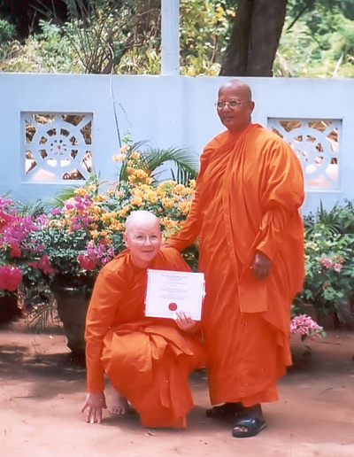
Ayya Sobhana
Trained by Bhante Gunaratana of Bhavana Society
2006 Higher ordination in Dambulla, Sri Lanka
2010 Prioress of Aranya Bodhi Hermitage in Northern CA
Notes:
Ayya Sobhana, trained by Bhante Gunarantana and ordained in Sri Lanka, has also been a prominent leader on the American bhikkhuni scene. She is the Prioress of Aranya Bodhi Hermitage in Northern California.
59

Slide 60
Ayya Medhanandi
Grew up in Montreal, Canada
Began meditation at age 21
Studied in N. India w. a Advaita sage
Returned to earn and Msc in Nutrition
Managed a global UN nutrition program for women and children
-1988 Took 10 precept with Sayadaw U Pandita in Burma
-Ten years at Amaravati Monastery in UK
-2007 Full bhikkhuni ordination in Taiwan
-2008 Returned to Canada and founded Sati Saraniya Hermitage in Perth, Ontario, where she is guiding teacher.
Read an interview with her on AfB website
www.bhikkhuni.net.
Notes:
Ayya Sobhana, trained by Bhante Gunarantana and ordained in Sri Lanka, has also been a prominent leader on the American bhikkhuni scene. She is the Prioress of Aranya Bodhi Hermitage in Northern California.
.

Slide 61

Hamburg Congress, 2007
Bhikkhunis and bhikshunis ordained earlier make plans to help mentor and ordain new bhikkhunis.
Notes:
Called by His Holiness the Dalai Lama, The Hamburg Congress in 2007, called, “The First International Congress of Buddhist Women’s Role in the Sangha” brought the issue of full ordination for women into world attention. Leading Buddhist monastics met to discuss the history and legitimacy of the ordination of women.
Pictured, left to right: Burmese Bhikkhuni Ven. Gunasari (retired physician); American Ven. Sobhana from Bhavana Society; British-born Ven. Tenzin Palmo (Cave in the Snow); American Ayya Tathaaloka, abbess of Dhammadharini; Ven. Dhammananda, first Thai bhikkhuni, renowned scholar
61

Slide 62

Rocking the Boat
2009 − With Ayya Tathaaloka as preceptor and Ajahn Brahm as certifying acariya, four samaneris were ordained as bhikkhunis at Bodhinyana Monastery in Serpentine, Australia.
Ajahn Brahm was then “delisted” from the Ajahn Chah lineage.
Ajahn Brahm and other monks
Notes:
As we mentioned the Thai Theravada tradition had forbid the ordination of bhikkhunis. In 2009, Ajahn Brahm took a very bold step. With Ayya Tathaloka as the preceptor, supported by Ayyas Sobhana and Sucinta, four nuns were ordained as bhikkhunis at Bodhinyana Monastery in Serpentine, Australia. Ajahn Brahm was a confirming bhikkhu. Since Ajahn Brahm was in the Ajahn Chah Thai lineage, which does not allow full ordination for women, Ajahn Brahm was ordered to Wat Pah Pong in Thailand. He was asked to recant and declare the ceremony was invalid and that these women were not bhikkhunis. He refused, and he and his monastery were “delisted” from the lineage he’d been part of for about 35 years.
62

Slide 63


August 2010 Bhikkhuni Ordination of four bhikkhunis at Aranya Bodhi Hermitage, Northern California
October 2010 Bhikkhuni Ordinations at Dharma Vijaya in Los Angeles
Notes:
In 2005, the North America Bhikkhuni Association was established with five bhikkhunis. Since then it has more than doubled in size.
In Aug. 2010 four women were ordained by Ayya Tathaaloka at Aranya Bodhi. After being ordained by the Bhikkhuni Sangha on one side, the bhikkhunis then went over to the assembled Bhikkhu Sangha for the confirmation of their ordination, which completed the bhikkhuni ordination. The four samaneri ordained as bhikkhunis: Ven. Thanasanti Bhikkhuni (United States), Ven. Adhimutta Bhikkhuni (New Zealand), Ven. Suvijjana Bhikkhuni (United States), and Ven. Phalanani Bhikkhuni (Germany) were ordained as bhikkhunis (fully ordained nuns) in the Theravada Buddhist tradition.
The following month five women were fully ordained at Dharma Vijaya in Los Angeles.
Three ceremonies were held on the same day. The first was for a Canadian-born woman, Brenda Batke-Hirschmann, who became an anagarika by taking Eight Precepts; the second was for two American-born anagarikas who received ordination as samaneris; and the third was for five samaneris who took full upasampada, or higher ordination, as bhikkhunis. The new samaneris are Santussika and Dhammapali; the new bhikkhunis are Lakshapathiye Samadhi (born in Sri Lanka), Cariyapanna, Susila, Sammasati (all three born in Vietnam), and Uttamanyana (born in Myanmar).
63

Slide 64

Three More North American Bhikkhunis Spirit Rock Meditation Hall – Oct. 17, 2011
Ed Ritger
L-R: Ayya Nimmala, Sati Saraniya Hermitage, Ontario, Canada; Ayya Santacitta and Ayya Anandabodhi, Aloka Vihara, San Francisco, California
Notes:
The next year three more bhikkhunis were ordained on Oct. 17, 2011 at Spirit Rock Meditation Hall. It was significant is that it was very much ‘mainstream’ and widely attended by bhikkhus and bhikkhunis from around the world. –L-R: Ayya Nimmala, Sati Saraniya Hermitage, Ontario, Canada; Ayya Santacitta and Ayya Anandabodhi, Aloka Vihara, San Francisco, California.
In 2012 there two further full ordinations, one in Northern California and one in Southern California.
64

Slide 65

A ‘Sima of Flowers’
Ed Ritger
Notes:
For an ordination, or any monastic ceremony, a sima, or sacred circle is established within which only the monastics are allowed. At monasteries in Thailand old large dark stone markers are often used by monks to tie the string around. At this ordination the sima markers had been built into the building itself below ground. The were marked above ground with tall plant stands bearing sima marker stones, with flowers cascading down from the pots. A very feminine touch!
65

Slide 66

Bhikkhunis Worldwide!
Today there are now bhikkhunis & bhiksunis in the U.S., India, Italy, Germany, Canada, Australia, New Zealand, Sri Lanka Thailand and Vietnam.
Notes:
So today there are bhikkhunis and bhikshunis worldwide. In order to continue to thrive they need our support.
66

Slide 67

Alliance for Bhikkhunis
Alliance for Bhikkhunis (AFB) was founded in 2007 to support the creation of a Bhikkhuni Sangha in the U.S. and its revival overseas.
Bhikkhunis near Joshua Tree National Park, Mohave Desert, Southern California, USA
Notes:
So, now a little about Alliance for Bhikkhunis (AFB) and what they do. It was founded in 2007 as a 501 (c)(3) non-profit organization to help support the creation of a Bhikkhuni Sangha in the U.S. and its revival overseas.
As we mentioned, Theravada bhikkhunis and bhikkhus take vows comparable to Christian vows of poverty. Their only possessions are their robes and their eating bowls. They cannot drive, handle money, hold jobs, cook their food, nor many other things. Try to imagine how you would exist if you lived like this. They are totally dependent of others for everything in their lives. Could you live like that? Give up all your attachments??!!
67

Slide 68
What Do We Do?
AFB educates both lay practitioners and monastics about the essential role bhikkhunis play in preserving the Dhamma.
AFB raises funds to be able to offer financial assistance to provide Theravada bhikkhunis and samaneris (novices) not only with their four requisites: food, clothing, shelter and medicine/health care, but other needs that may arise.
Notes:
Probably the two most important undertakings of the Alliance for Bhikkhunis are:
1) To educate lay practitioners about the essential role bhikkhunis play in preserving the dharma.
2) AFB raises money so that it can offer financial assistance to provide monastics, not only with their four requisites: food, clothing, shelter and medicine/health care, but also other expenses that may arise.
68

Slide 69

Educate, Inform and Connect
Present Magazine (Discontinued, but now Archived on the Website)
Website bhikkhuni.net
Facebook
Notes:
In adddition, Alliance for Bhikkhunis, through its online magazine Present and its digital Library, provides information on bhikkhuni news, activities, challenges, achievements and history. Through its Facebook page, it creates a virtual community.
So much of the work of the Alliance for Bhikkhunis is the dispelling of misconceptions about bhikkhunis and their history, and the empowering of women through a recovery of their spiritual legacy and education about the attainments and achievements of past and current bhikkhunis. Vital to these tasks is the additional activity of educating lay practitioners about why it is essential to have women monastics in the modern world.
69

Slide 70

International Bhikkhuni Day
The September full moon is the lunar anniversary of the foundation of the Bhikkhuni Sangha, and with it, the fulfillment of the Buddha’s Fourfold Sangha.
This year marks the 2596th anniversary.
Notes:
Alliance for Bhikkhunis’ Annual International Bhikkhuni Day is a critical component of AfB’s mission to educate and honor and celebrate bhikkhuni history. This annual event is one of the primary ways the AfB protects the inspiring stories of women monastics as well as enlightened laywomen.
70

Slide 71
Health Care and Medicine
Steward for a fund that pay insurance premiums for several bhikkhunis without health insurance.
Directly channel supporters’ contributions for bhikkhunis’ medical and dental care.
Notes:
Alliance for Bhikkhunis is the steward by a very generous anonymous donor which pays for medical and dental health care as well as insurance premiums for some bhikkhunis.
According to Ayya Tathaaloka: Several women who thought about ‘going forth’ had to reconsider when confronted with the fact that there were not funds for health care coverage. She has also not been able to accept other women from other countries who are bhikkhuni candidates as they cannot provide health coverage. They have joked that they are only able to accept women who are ‘DNR’ ‘Do Not Resuscitate’! The Dhammadharini Board does not want to accept any new candidates under these conditions.
71

Slide 72

Assist in Travel to Conferences, Retreats, and Travel for Vassa
Notes:
Alliance for Bhikkhunis contributed to transportation and conference costs so bhikkhunis could attend the International Sakyadhita Conference in India this year. Some of the funds went to support the participation of Indian former ‘Dalit’ or ‘untouchable’ bhikkhunis.
72

Slide 73

AfB Raises Funds for Financial Assistance for Monastics
.
Gathering of North American Bhikkhunis at ‘Bhikkhuni Sangha Camp’ at Aranya Bodhi in Northern California, 2013
Notes:
The AfB also pays for travel so bhikkhunis can come together during Vassa and attend retreats.
73

Slide 74
Here are some of the other projects we have supported in 2012 & 2013 with your generous donations (see details at www.bhikkhuni.net) Education & Outreach: -Contributing to the Saranaloka Foundation video “New Beginning” shown at several conferences (see Saranaloka website) Ordinations: -Donations toward an ordination ceremony at Mahapajapati Monastery in Southern California Establishing Monasteries East & West: -Contributed to the temple building funds in Canada and Sri Lanka -Contributing to the purchase of supplies for a bhikkhuni monastery in Thailand.
Notes:
Go through the slide.

Slide 75
Offering Pavarana
Dear Venerable Bhikkhunis:
On behalf of the Alliance for Bhikkhunis, we invite and welcome you and your monastic community to let us know of your essential requisite needs beyond what is supported by your lay supporters and community. As much as we are able, we would like to contribute to these needs to maintain your monastic life path and practice. In addition to the four requisites of robes, food, shelter and medicine, we may also be able to contribute to transportation, education and training, and other extra-requisite needs or projects. We invite you to inform us of these needs by filling out an online form or a Word form that allows us to begin communicating with you and evaluating your requests. We are interested in supporting bhikkhunis as much as we are able to with the support that is contributed to us.
Notes:
Since bhikkhunis can’t ask directly for their needs with out a Pavarana (an invitation) we have posted Our Pavarana on our website and invite them to let us know of their needs. People are able to make donations directly on our website through Pay Pal, or by mailing a check. As we get requests we post them on our website www.bhikkhuni.net. Please visit our website and please consider a donation on our website, Pay Pal or by-mail.

Slide 76
Here are some of the projects we have had requests to support:
Research, Education & Training -Support costs of Translation of the Vibhanga (Monastic Code) ~ $5000 Founding, Development & Support of Bhikkhuni Monasteries -Founding Charlotte Buddhist Vihara -Establish new location for Dhammadharini Vihara -Mahapajapati Women's Monastery (Property Taxes - $2110) -Building fund for shrine room at Karuna Savena, Czech Republic - ~$280,000
Notes:
Go through the slide.

Slide 77
Alliance for Bhikkhunis
Protecting bhikkhunis, we protect ourselves and future generations.
Notes:
By protecting bhikkhunis, we protect ourselves and future generations.
77

Slide 78

Thank You!
Notes:
The Bhikkhuni Sangha thanks you for your support!
Thank you again for coming and sharing in this celebration.

Slide 79

May all beings be happy!
Notes:
May all beings be happy.
79

Slide 80
With Gratitude
With much gratitude to Ayya Tathaaloka, Abbess of Dhammadharini Vihara for her pictures and contributions to the text.
With Gratitude to Alice Collette, PhD, Det. Of Theology & Religious Studies, York St. John University, York, UK
Thank you to Mary Watt for reading the research on the Seven Sisters and ‘getting us started’.
Notes:
Alliance for Bhikkhunis wishes to thank the following people for their contributions toward this presentation: Ayya Tathaaloka, Dr. Alice Collette and Mary Watt.

